Slide 1
Azure Solution Alignment Workshop
Module 4 – Networking

Slide 2
High-level agenda
Identify current networking strategies and environments
Virtual Networks
Gateways
VNet Peering
ExpressRoute
Site-to-site VPN
DNS
DHCP
IP addressing
Load balancing
System routing
Next steps

Slide 3
Networking overview

Slide 4
The Microsoft network
85 iXP
1.4 M
4 X
15 B
+ CONNECTIONS
TO 1695 NETWORKS
MILES OF FIBER IN OUR DATACENTERS
WRAP THE EARTH IN NORTH AMER. FIBER
MICROSOFT CLOUD INVESTMENT

Slide 5
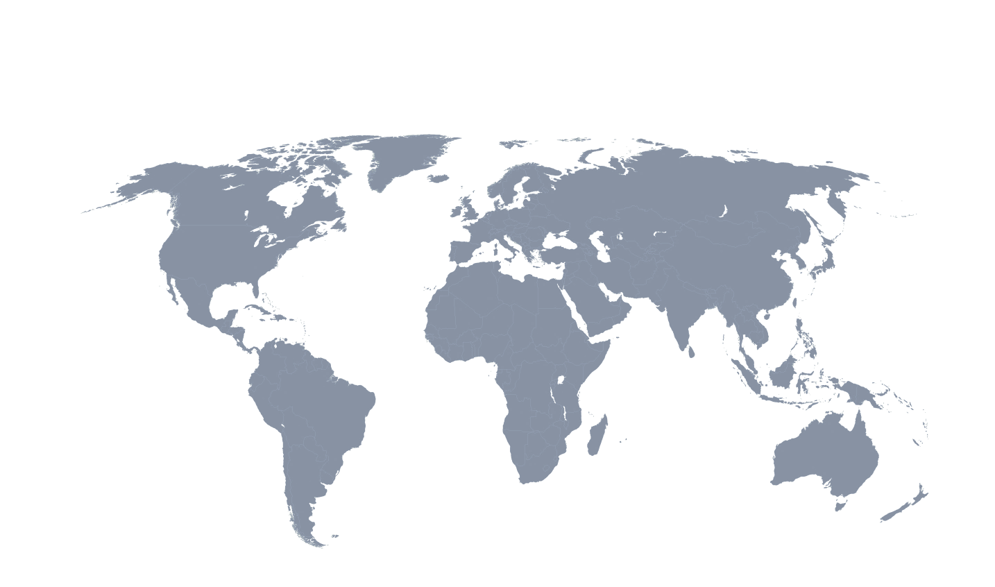
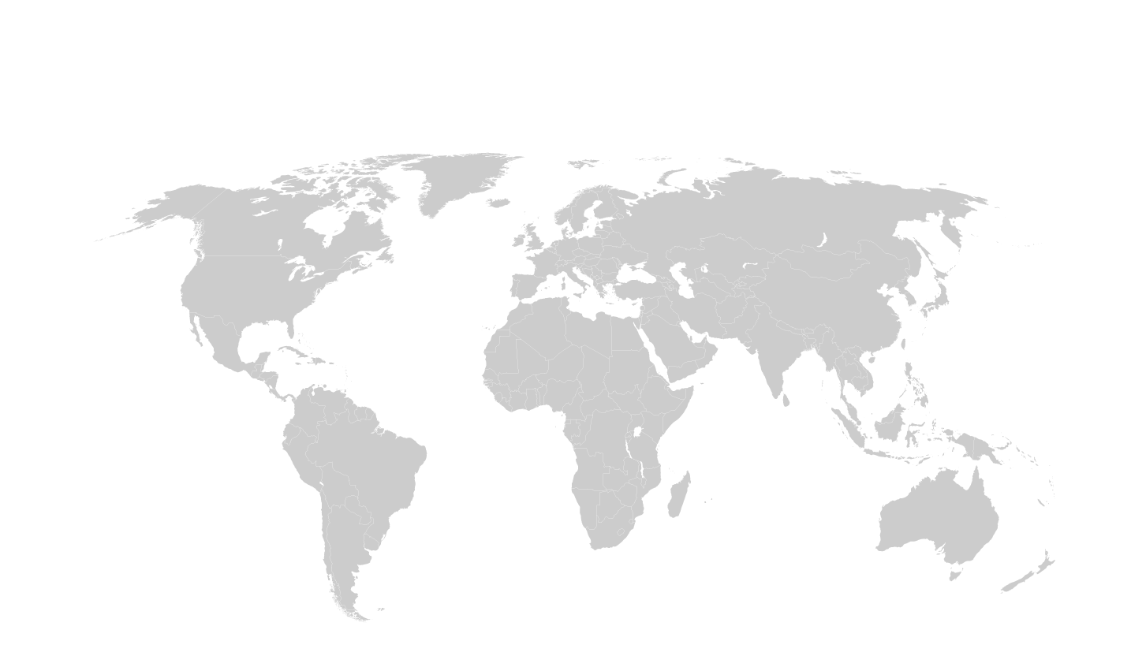
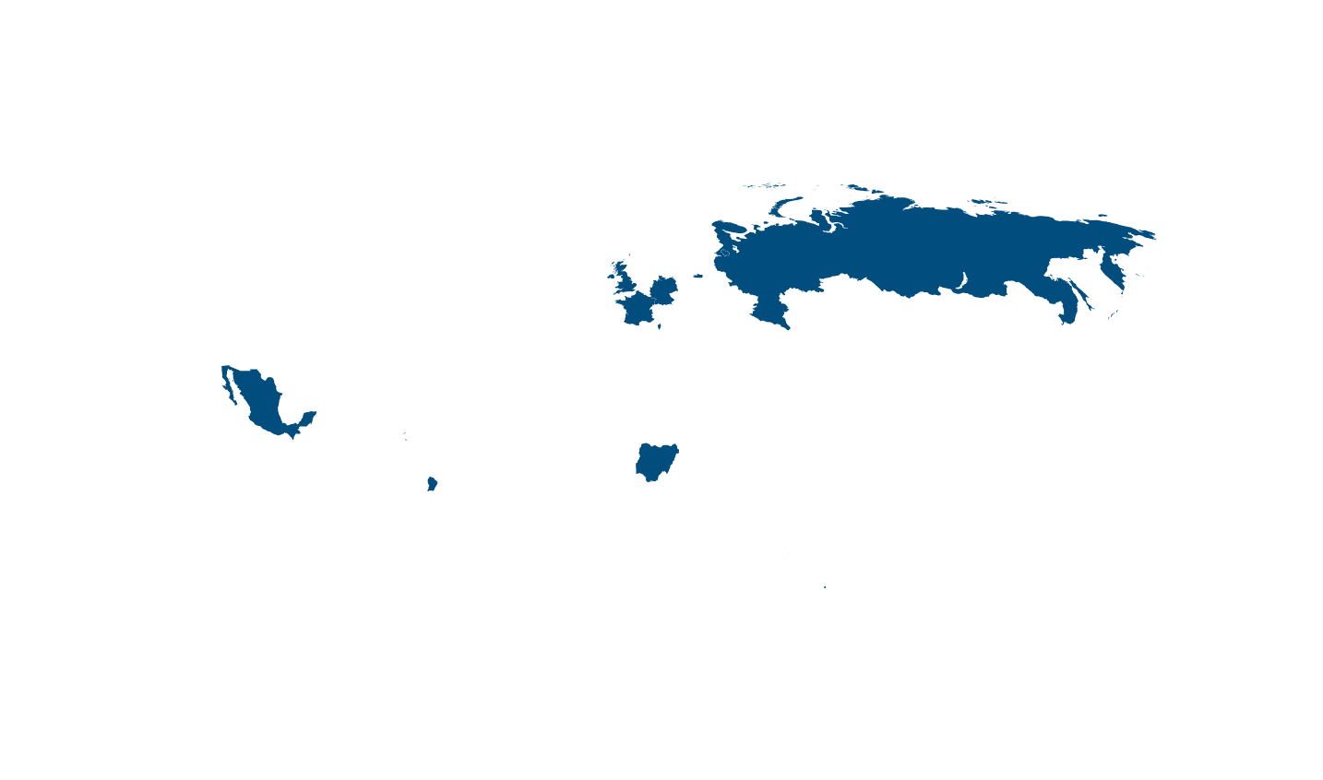
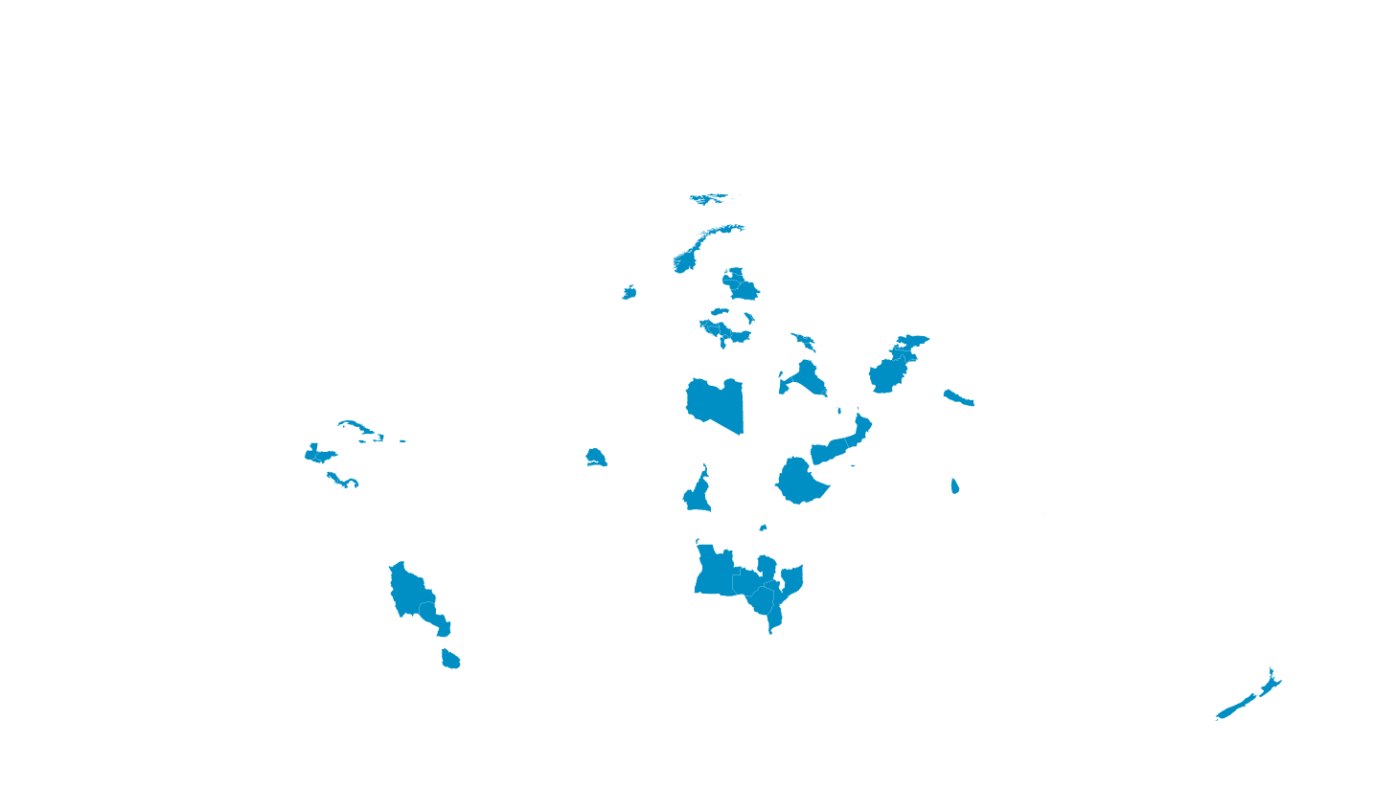
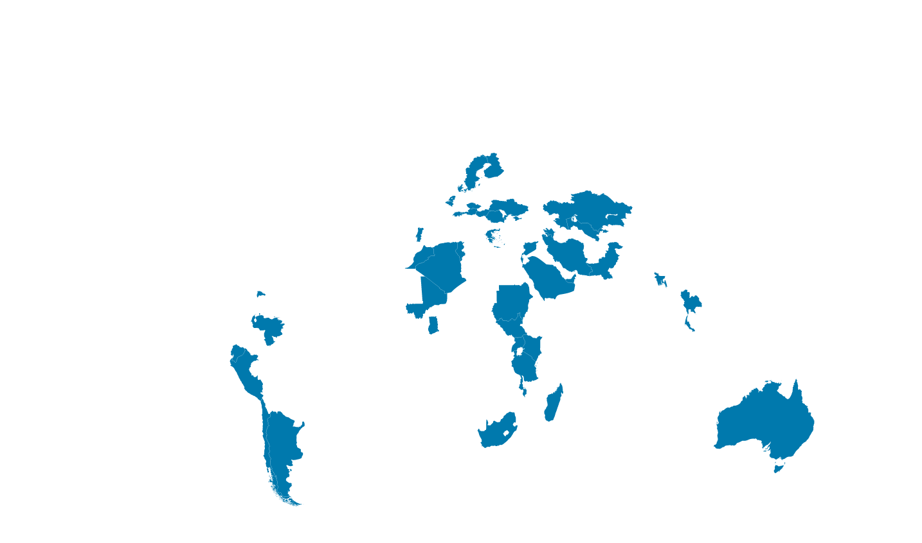
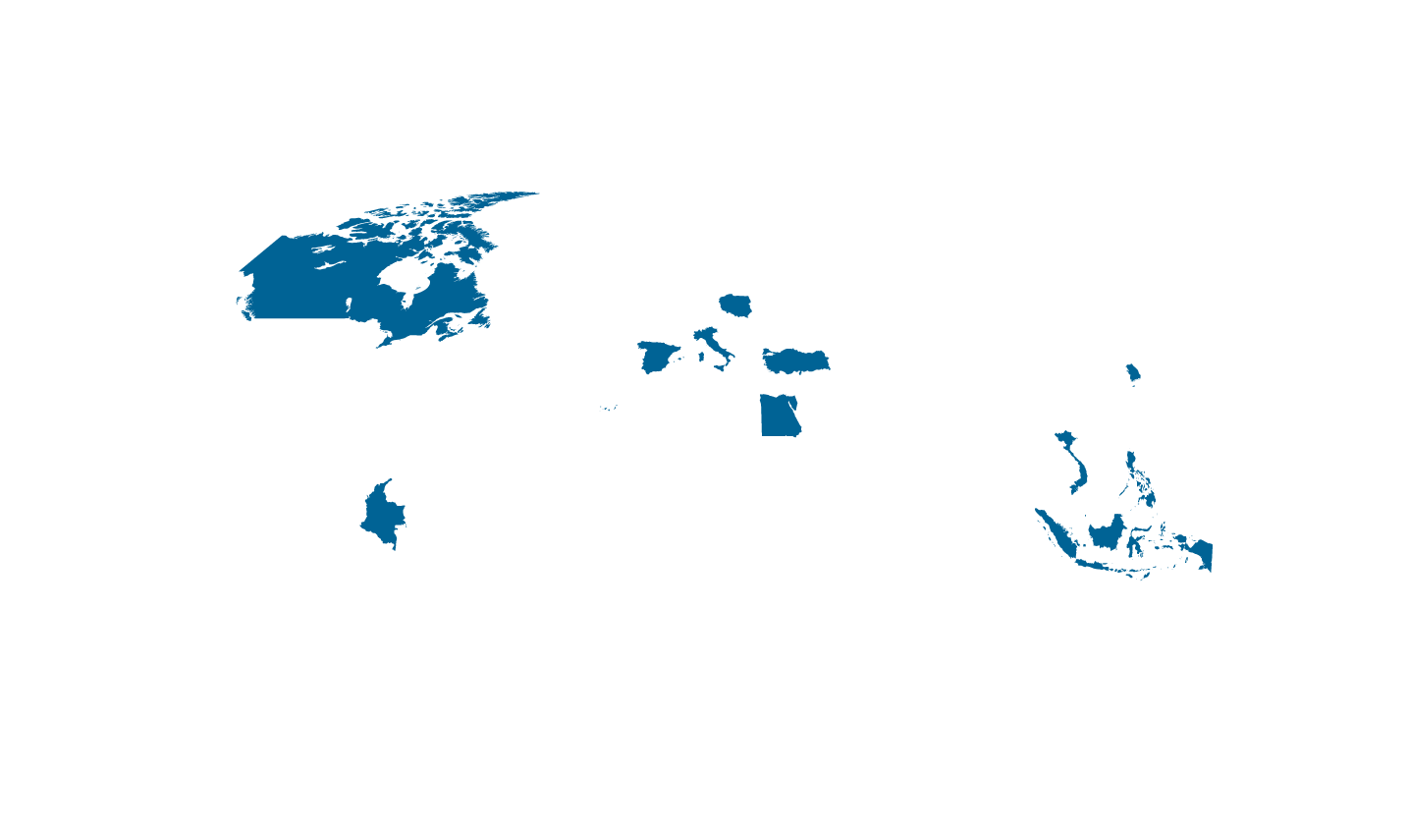


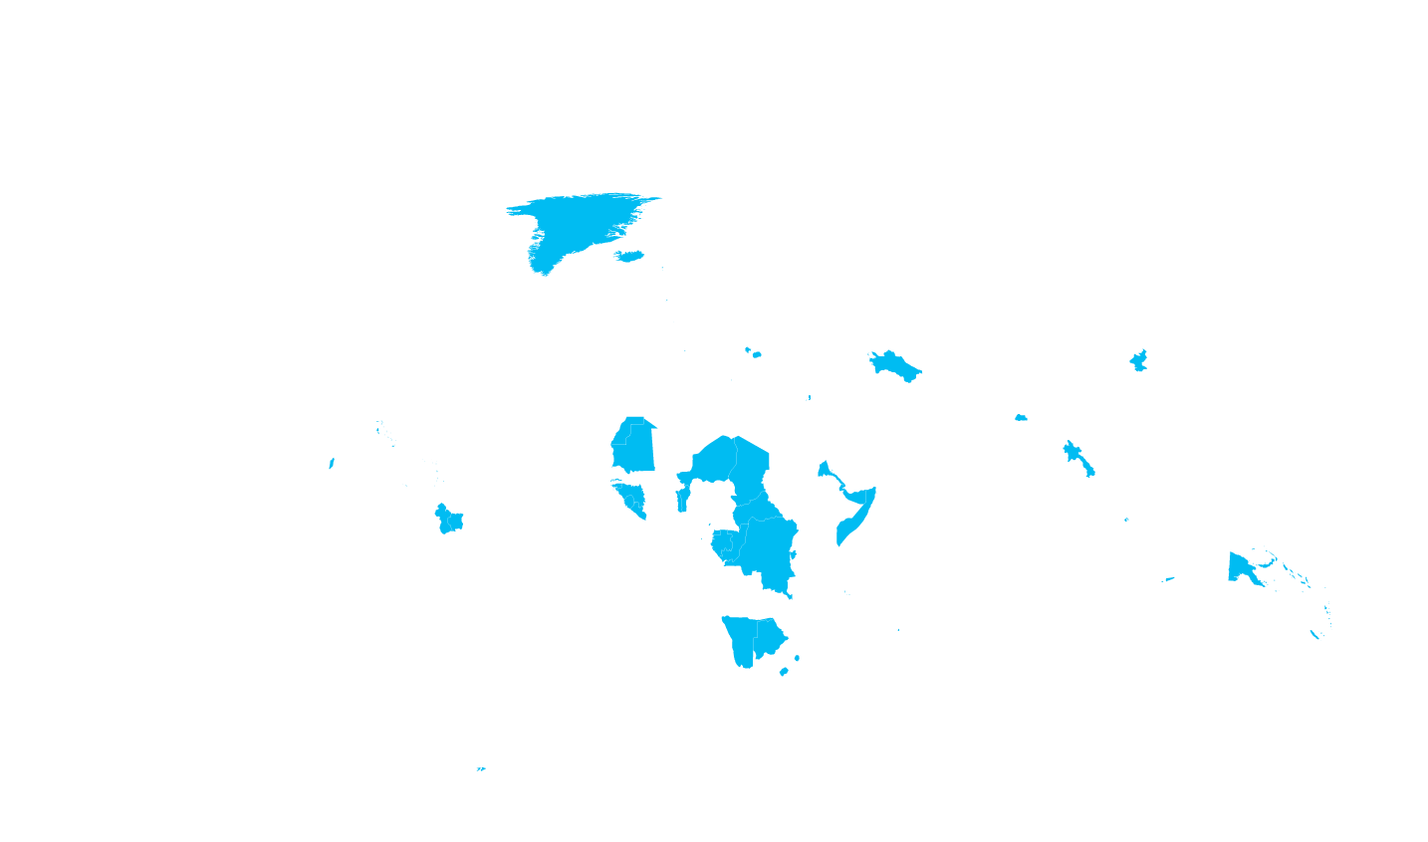




Internet connectivity by country
Microsoft Azure datacenter regions
Microsoft’s network is one of the largest in the world
INDIA NORTH
TBD
Internet users
■ 500,000,000+
■ 100,000,000 – 499,999,999
■ 50,000,000 – 99,999,999
■ 25,000,000 – 49,999,999
■ 5,000,000 – 24,999,999
■ 100,000 – 4,999,999
■ 50,000 – 999,999
■ 0 – 49,999

Slide 6
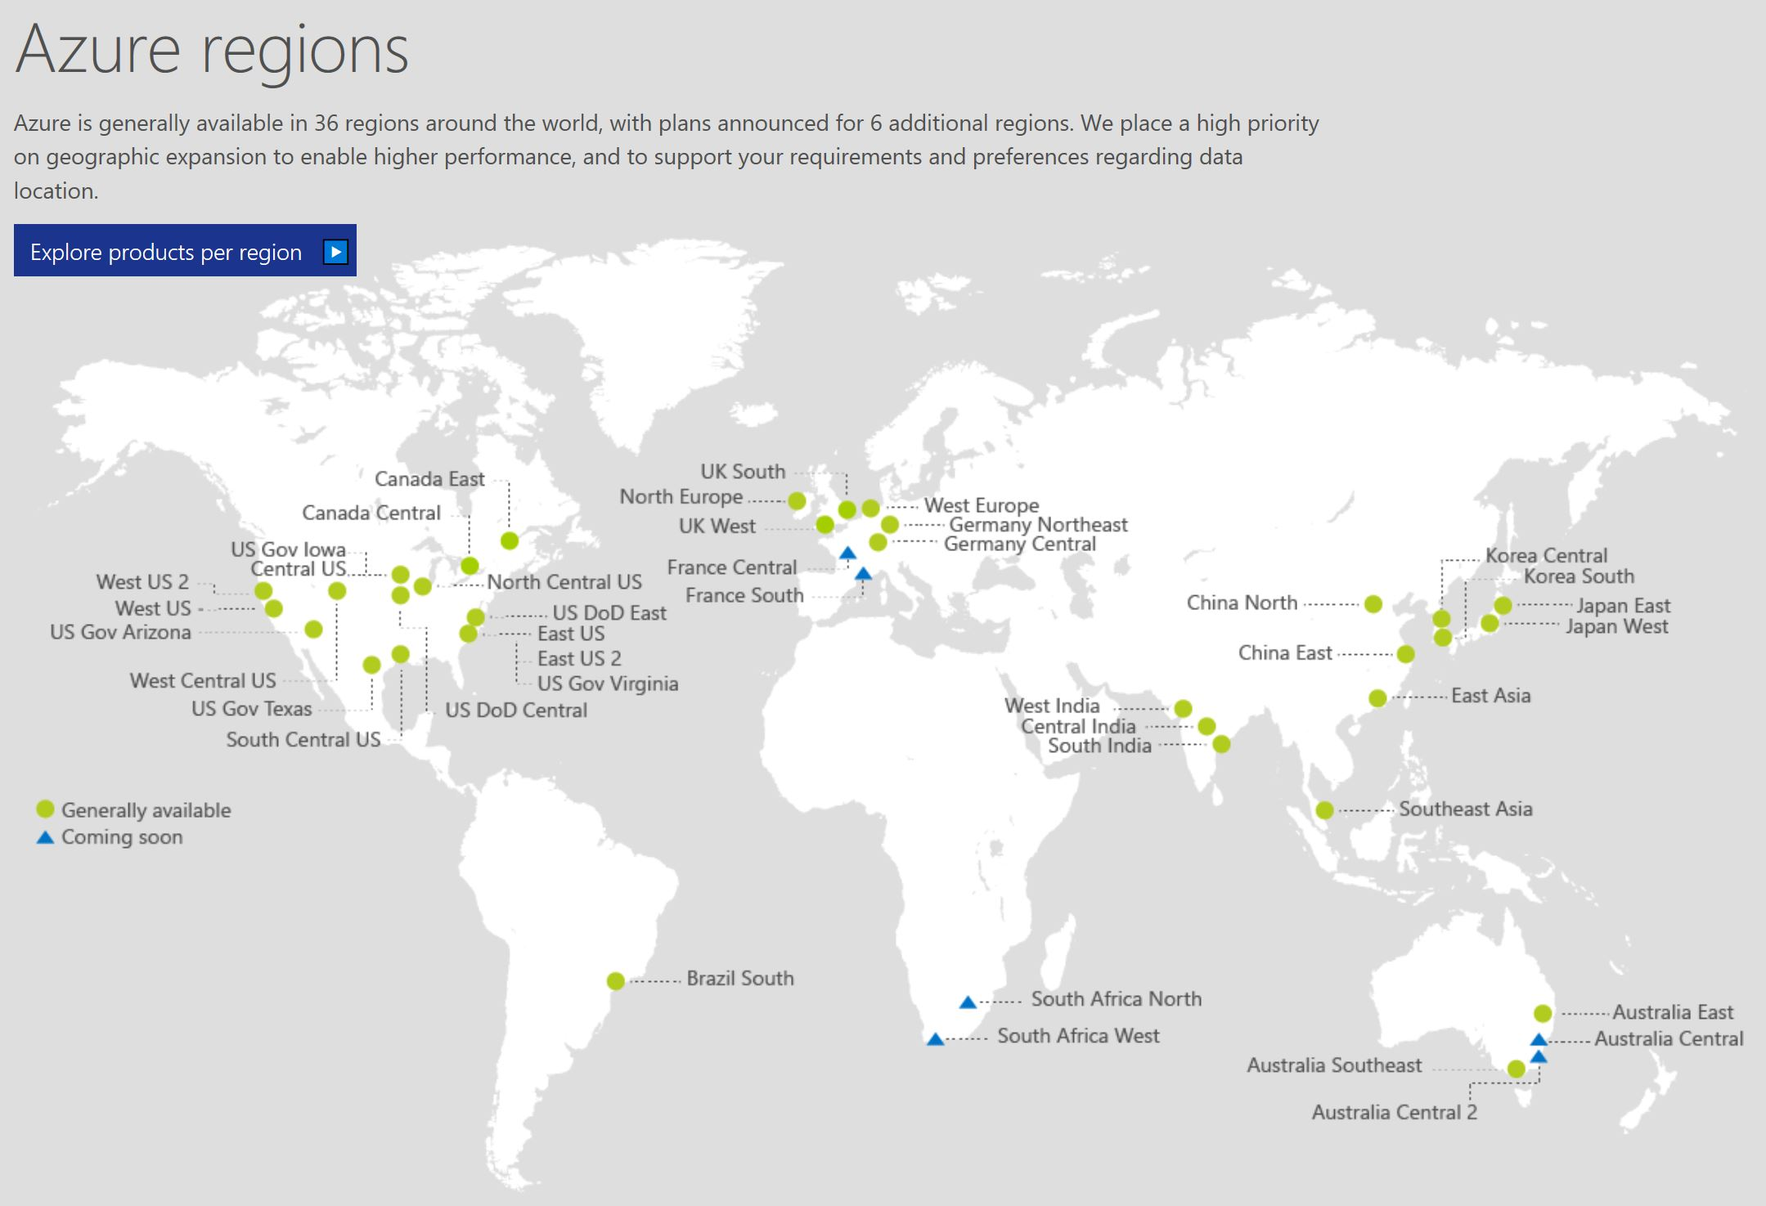

Dec 2017

Slide 7
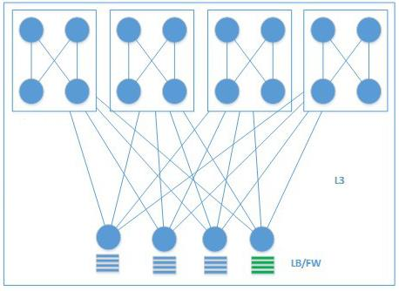
Classic vs. hyper-scale networks
Large L2 domains
L3 at all layers
HW-based service
Software
service
L3
L2
Simple Tree Design
Clos-based design
Agility
Automated provisioning, integrated process
Diversity and manual provisioning
Complex hardware and lack of automated operations
Efficiency
Simplify requirements, optimize design, and unify infrastructure
Availability
Resilient, automated monitoring and remediation, low human involvement
High complexity and human error

Slide 8
Software-defined networking (SDN)
Building the right abstractions to enable scale and agility
Azure
Front-end
Abstract Management, control, and data planes
Tenant Compose compute & storage roles and networks
Tell and program Instead of discover and react
Management
Plane
Application
Plane
Proprietary
Hardware
Appliance
Commodity
Hardware
Control
Plane
Controller
Physical
Transport
Plane
Control
Plane
Example: ACLs
Management | Create a tenant
Control | Plumb tenant ACLs to switches
Data | Apply ACLs to these flows
Switch

Slide 9
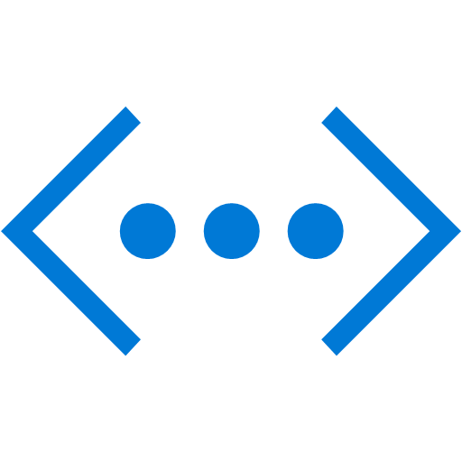
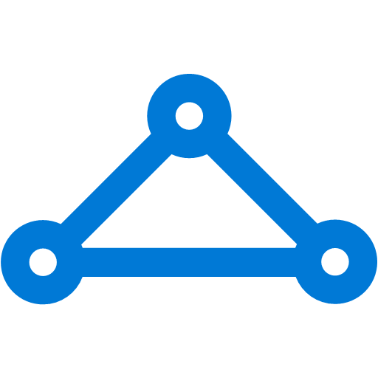
The big (network) picture
Virtual Network
“Bring Your Own Network”
Segment with subnets and security groups
Control traffic flow with user- defined routes
Azure
Virtual Network
Peering
Users
Internet
Azure
Virtual Network
VNet peering
Front-end access
Dynamic/static public IP addresses
Direct VM access, NSGs for security
Load balancing
DNS services: Hosting, traffic management
DDoS protection
ExpressRoute
VPN Gateways
Back-end connectivity
Point-to-site for dev/test
Peering for cross –VNet connectivity in the same region
VPN Gateways for secure cross region connectivity
ExpressRoute for private enterprise grade connectivity

Slide 10
New network features
Network Watcher
Multiple IPs per NIC
Multiple NICs for all VMs
Web Application Firewall
VNET Service Endpoints
Application Security Groups & NSG Service Tags
Azure DNS Private Zones
Load Balancer Standard
P2S VPN Domain Authentication
Cross-Region Peering
Direct Access to Network Hardware

Slide 11
Azure network building blocks

Slide 12
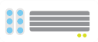

Azure Virtual Networks
Virtual Networks are the primary building block for Azure networking
Private network in Azure based on address space prefix
Create subnets with your private or public IP addresses
Bring your own DNS or use Azure-provided DNS
Connect on-premises or to the internet
Control traffic flow with user-defined routes
Internet
VPN &
ExpressRoute
Direct internet
connectivity
Azure
VPN GW
Back-end
10.3/16
Mid-tier
10.2/16
Front-end
10.1/16
AD / DNS
Virtual Network

Slide 13
DHCP
Azure provided/managed service
All addresses are DHCP-based
Address not allocated until object created
Addresses are recovered when object is deallocated
Static addresses are DHCP reservations
Address prefix comes from VNet/subnet definitions
Beware: using Group Policy to configure DHCP can result in isolated VM without any IP address.

Slide 14
Routing within a Virtual Network
All subnets can see/route to all other subnets
Virtual Network subnets (multiple)
Gateway subnet (single)
One logical gateway per gateway subnet
All traffic flows through gateway to get to on premises
Influence routing with user-defined routes (e.g. NVA, S2S Forced Tunneling) and BGP (e.g. ER Forced Tunneling)
By default, each VNet has outbound internet access (NAT)

Slide 15
Route tables
Every subnet has a route table that contains the following minimum system routes:
Local VNet – Route for local addresses (no next-hop value)
On-premises – Route for defined on premises address space (VNet gateway is next-hop address)
Internet – Route for all traffic destined to the Internet (Internet Gateway is the next-hop address)
Route tables can be influenced using:
BGP routes (using ExpressRoute, preferred over system routes)
User-defined routes (preferred over BGP and system routes)

Slide 16



User-defined routes
Control traffic flow in your network with custom routes
Attach route tables to subnets
Specify next hop for any address prefix
Set default route to force tunnel all traffic to on-premises or appliance
Internet
Virtual Network
VM with “IP Forwarding”
System
Route
Front-end subnet
Back-end subnet
System route
Default Route
VM/Appliance
User-defined route

Slide 17
User-defined route limitations
UDR can now be applied to the Gateway subnet
UDR only affects outbound traffic
Route decisions made based on Longest Prefix Match (LPM)
If LPM matches, then UDR ->BGP->System route in priority order

Slide 18
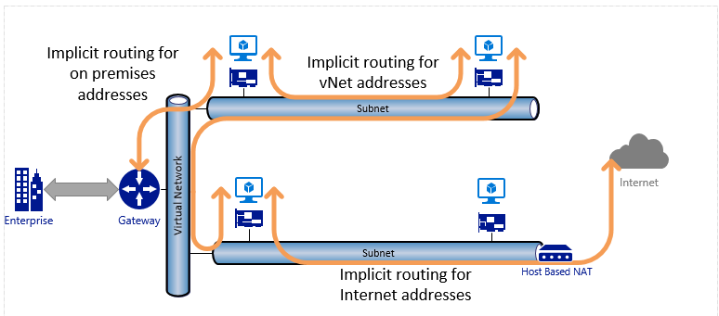
Network routing models – Default routing in a subnet
If address is within the VNet address prefix – route to local VNet
If the address is within the on premises address prefixes or BGP published routes (BGP or Local Site Network (LSN) for S2S) – route to gateway
If the address is not part of the VNet or the BGP or LSN routes – route to Internet via NAT
If destination is an Azure datacenter address and ER public peering is enabled, it is routed to the gateway
If the destination is an Azure datacenter with S2S or an ER without public peering enabled, then it is routed to the Host NAT for Internet path, but it never leaves the datacenter
1
2+4
1
3+5

Slide 19
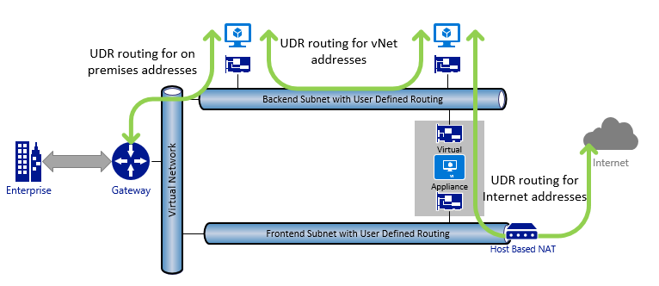
Network routing – UDR and Virtual Appliances
If UDR is defined with NextHop LOCAL routing, then route to a VM in the VNet based on address
If UDR is defined with NextHop VPN Gateway routing, then route to a machine on-premises based on address
If UDR is defined with NextHop Appliance routing, then route to the virtual appliance based on address
If UDR is defined with NextHop Internet routing, then route to the Internet over the Host NAT

Slide 20
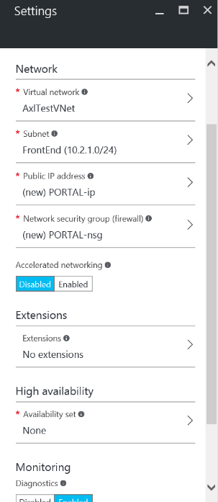
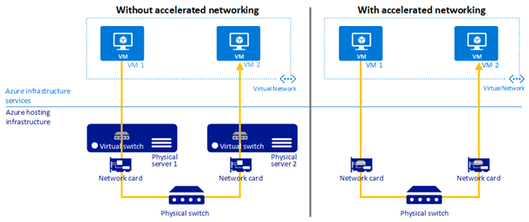
Accelerated networking
High throughput, low latency network performance
Enables SR-IOV – direct VM-to-NIC path bypassing Hyper-V (Host OS) layer
Up to 10x lower network latency (intra VNet 30 µs RTT)
High throughput (25Gbps with DS15v2 VMs)
Increased number of packets per second (pps) and reduced jitter
1.5x Azure SQL DB throughput improvements (1KB commits)
Available for Windows (GA) & Linux (Public Preview)
Notes:
June 2017 –
Limitations
The following limitations exist when using this capability:
Network interface creation: Accelerated networking can only be enabled for a new NIC. It cannot be enabled for an existing NIC.
VM creation: A NIC with accelerated networking enabled can only be attached to a VM when the VM is created. The NIC cannot be attached to an existing VM.
Regions: Windows VMs with accelerated networking are offered in most Azure regions. Linux VMs with accelerated networking are only offered in two regions: South Central US and West US 2. The regions this capability is available in will expand in the future.
Supported operating systems: Windows: Microsoft Windows Server 2012 R2 Datacenter and Windows Server 2016. Linux: Ubuntu Server 16.04 LTS with kernel 4.4.0-77 or higher. Additional distributions will be added soon.
VM Size: General purpose and compute-optimized instance sizes with eight or more cores. For more information, see the Windows and Linux VM sizes articles. The set of supported VM instance sizes will expand in the future.
Changes to these limitations are announced through the Azure Virtual Networking updates page

Slide 21
Azure DNS
Azure DNS
Manage DNS seamlessly with your Azure services
Globally distributed architecture, resilient to multiple region failure
Fast global DNS name resolution
99.99% Availability SLA
All common DNS record types
A, AAAA, CNAME, MX, NS, PTR, SOA, SRV, and TXT
Flexible DNS management
Integrated with Azure Resource Manager for role-based access control, tagging, and template-based deployment—for both zones and record sets
Azure Portal, PowerShell, and CLI
REST API and SDKs for application integration

Slide 22
Name resolution
DNS for private addresses
Specify DNS servers per subscription
Assign DNS servers per VNET
DNS for public addresses
Automatic registration to defined Azure zones
CNAMES can be created in customer zones
DNS hosting
Azure hosted public-facing DNS servers

Slide 23

DNS names for public IP
FQDN access to a Virtual Machine
Available for Virtual Machines
Automatic DNS registration/ de-registration during scale-up, scale-down
Internet
Webrole.1.contoso.cloudapp.net 130.26.5.120
Webrole.0.contoso.cloudapp.net 130.26.10.80
Contoso App with 2 virtual machines
VM Instance 1
VM Instance 2

Slide 24
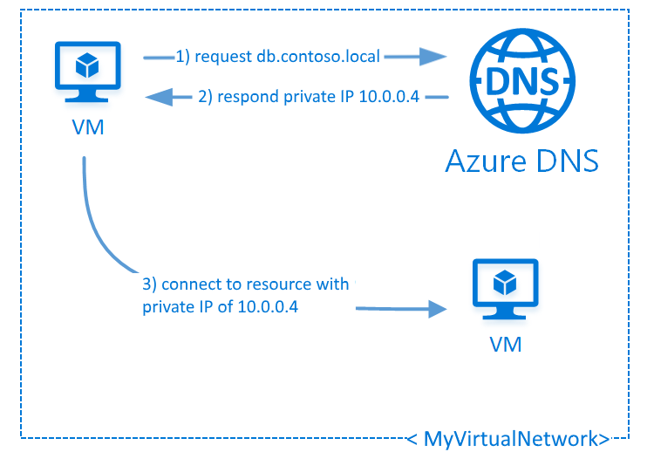
Azure DNS Private Zones
Preview
Host DNS Zones in VNET
Eliminates need to add custom DNS solution
Enables ability to use custom domain names
Split-Horizon DNS Support
Create zones with the same name that resolve to different answers
Provide a dedicated version of a service for use inside a vNet
Hostname resolution between vNets
Private DNS zones can be shared between vNets
Simplify cross-network and service discovery scenarios such as vNet peering

Slide 25
Azure Load Balancer hierarchy
Azure service | What | Example
Traffic Manager | Cross-region redirection & availability | http://news.com ➔ apac.news.com ➔ emea.news.com ➔ us.news.com
Azure Load Balancer | In-region scalability & availability | emea.news.com AppGw1 AppGw2 AppGw2
Azure Application Gateway | URL/content-based routing & load balancing | news.com/topnews news.com/sports news.com/images
VMs | Web Servers | IIS, Apache, Tomcat
Internet
Azure traffic manager (DNS load balancer)
ALB (L4 load balancer)
ALB (L4 load balancer)
Application
Gateway
Application
Gateway
Application
Gateway
Application
Gateway
VM
VM
VM
VM
VM
VM
VM
VM

Slide 26
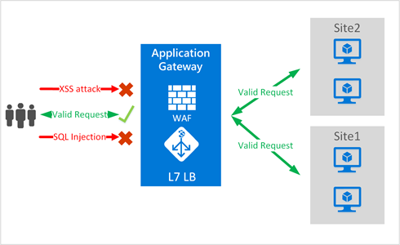
Azure Application Gateway Web Application Firewall
Optional feature for Application Gateway
OWASP based web vulnerability protection
Configurable rulesets
SSL policy support
Web traffic redirection
Firewall support

Slide 27
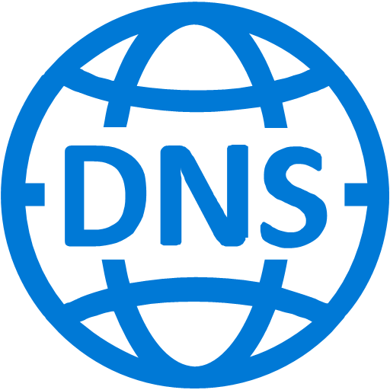
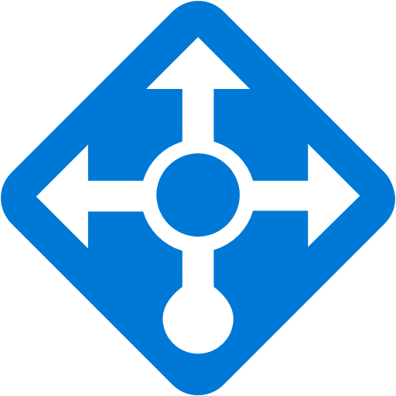
IPv6 for Azure VMs
Native IPv6 to VMs
Both inbound and outbound
Initiated by internet clients or initiated from Azure VMs
Load-balanced IPv6
Native dual-stack (IPv4+IPv6) VMs
Supported for both Linux & Windows VMs
ARM only
Available globally
IPv6 Drivers
IPv6 required by governments and their suppliers
US, AU, CA, CH, CN, ID, IN, PH, SE, SG, TR
Enable dual-stack mobile (4G) & IOT services
Apple iOS highlighting IPv6 support
Azure
Azure VMs (IaaS)
VM
VM
VM
IPv6
IPv4
Azure Services & Storage
IPv6 (AAAA)
Record
IPv6
VIP
IPv4
VIP
Azure
Load Balancer
Inbound
&
Outbound
Internet
IPv6 Clients & Services
IPv4 Clients and Services

Slide 28


NIC enhancements
MAC Persistence
MAC address preserved across stop-start
NIC order maintained after VM start
Load balancing for all NICs
External LB and internal LB support for all NICs
Direct public IP on secondary NICs
Multiple IPs on a NIC
Run multiple services with isolated security boundaries
Run multi-tenant services with single NIC VMs
Multiple NICs on all VMs
Isolate communication between data and management plane
Firewall Appliance
Internal LB
External LB
NIC1
NIC2
Enables new virtual appliance scenarios

Slide 29
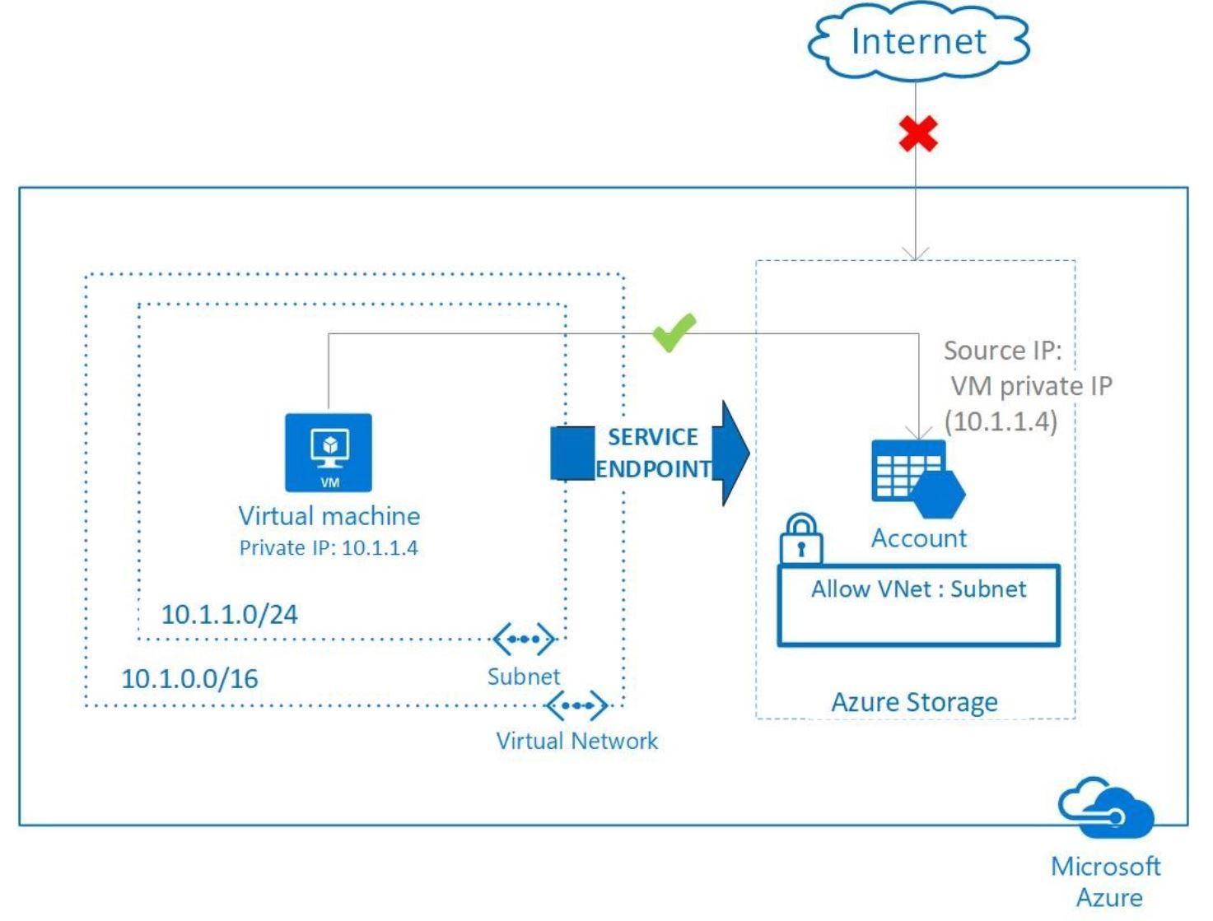
Virtual Network Service Endpoints
Preview
Restrict Azure Services to be accessible only within VNet
Prevent direct internet exposure to Azure Storage & SQL Database services
Currently only available for Azure Storage & Azure SQL Database in select regions
Extend Private IP Space to Azure Services
Enable VNet service endpoints on a subnet
Notes:
November 2017
https://docs.microsoft.com/en-us/azure/virtual-network/virtual-network-service-endpoints-overview
This feature is available in preview for the following Azure services and regions:
Azure Storage: All regions in the Azure public cloud.
Azure SQL Database: WestCentralUS, WestUS2, and EastUS.
Limitations
The feature is available only to virtual networks deployed through the Azure Resource Manager deployment model.
Endpoints are enabled on subnets configured in Azure virtual networks. Endpoints cannot be used for traffic from your premises to Azure services.
A service endpoint applies only to Azure service traffic within a virtual network's region. To support RA-GRS and GRS traffic for Azure Storage, endpoints also extend to include paired regions where the virtual network is deployed. Learn more about Azure paired regions.
Securing Azure service access from on-premises:
By default, Azure service resources secured to virtual networks are not reachable from on-premises networks. If you want to allow traffic from on-premises, you must also allow public (typically, NAT) IP addresses from your on-premises or ExpressRoute. These IP addresses can be added through the IP firewall configuration for Azure service resources.
ExpressRoute: If you are using ExpressRoute from your premises, for public peering, each ExpressRoute circuit uses two NAT IP addresses applied to Azure service traffic when the traffic enters the Microsoft Azure network backbone. To allow access to your service resources, you must allow those two public IP addresses in the resource IP firewall setting.

Slide 30
IP addressing models in ARM
Private IP
Public IP
Public Static
Private Static
Internal address assigned by default for Azure for communication within Virtual Networks
Assigned to a VM NIC or Internal Load Balancer
Public IP address assigned to a VM NIC or an external Load Balancer
Only exists when a LB is created or address is assigned to VM NIC
This is a static public-facing address that must be specially requested. There are a limited number of these addresses per subscription
Use only when you need a public facing static IP address
A static address allocated from the subnet address pool and is internal-facing only. The number is only limited by the number of addresses assigned to the subnet address pool. This is implemented as a DHCP reservation
Use only when you need an internal facing static IP address

Slide 31
Subnet addresses
Azure reserves the first three and the last IP from the pool
First usable address of a /24 is .4

Slide 32
IP reservation
Reserve static public IP addresses from Azure’s pool
Reusable
You have control over the IP addresses until you release them
Assign IPs to different types of objects

Slide 33
Azure network connectivity

Slide 34

Connectivity choices – Internet or private
Branch office 2
Branch office 2
Microsoft
Microsoft
WAN
WAN
Branch office 1
Branch office 1
Public internet
Public internet
Corp HQ
Corp HQ
IPsec VPN over Internet
Encrypted data traverses Internet to reach Azure
Limited bandwidth and higher availability
Cloud on your WAN
Traffic flows directly from customer WAN to Microsoft
Reduces complexity
Lower latency, higher bandwidth and higher availability

Slide 35

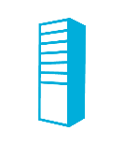
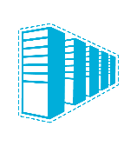
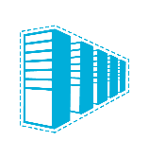

Connectivity options and hybrid offerings
Cloud
Customer
Segment and workloads
Consumers
Access over public IP
DNS resolution
Connect from anywhere
Internet connectivity
Developers
POC Efforts
Small scale deployments
Connect from anywhere
Secure point-to-site connectivity
SMB & enterprises
Connect to Azure compute
Secure site-to-site
VPN connectivity
SMB & enterprises
Mission critical workloads
Backup/DR, media, HPC
Connect to all Azure services
ExpressRoute private connectivity
SMB & enterprises
High performance workloads
Latency sensitive workloads
Connect to Azure Compute in same region
Virtual Network peering

Slide 36


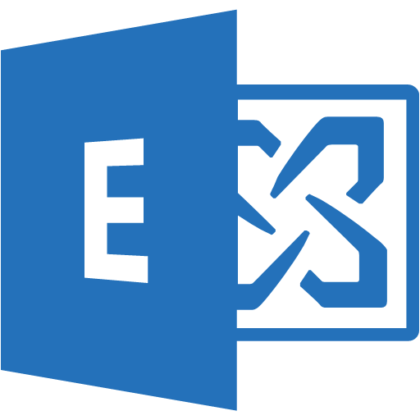
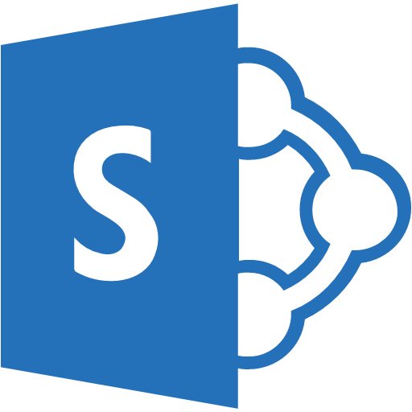


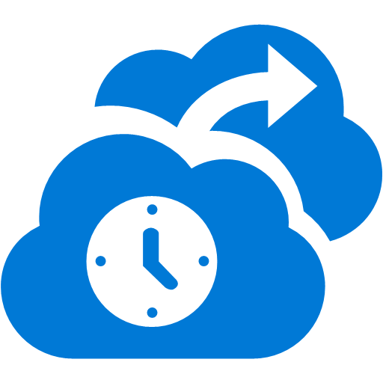



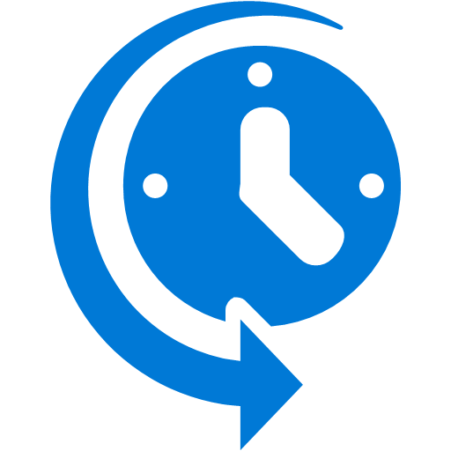



Cross-premises connectivity overview
Azure
Internet
Virtual Network
P2S SSTP Tunnels
Back-end
Mid-tier
Front-end
IPsec S2S VPN Tunnels
Private WAN
ExpressRoute

Slide 37
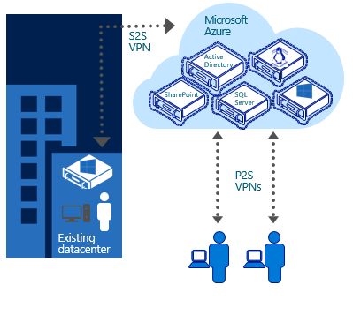
Point-to-Site VPN connectivity
Connect from anywhere securely (root+client cert)
No SW installation required (32/64-bit .exe for client config)
Easy to setup and use (Windows and Mac clients)
Ideal for prototyping, development, demos
P2S and S2S coexist
Notes:
GA at Ignite 2017:
P2S VPN for Macs and AD Domain authentication for P2S VPN is now generally available through Azure Networking.
Customers will be able to connect to Azure Virtual Networks over P2S VPN from their Mac machines using the native IKEv2 VPN client. SSTP continues to be the P2S solution for Windows. Customers will be able to support a mixed client environment consisting of both Windows and Macs by enabling both IKEv2 and SSTP VPN.
Customers will be able to use the organization domain credentials for IKEv2 and SSTP VPN authentication by enabling RADIUS authentication. The Azure VPN Gateway will integrate with the customer's RADIUS and AD Domain deployment in Azure or on-premises datacenter. RADIUS servers will integrate with other identity providers too, providing multiple useful authentication (including Multi-Factor Authentication) options for P2S VPN.

Slide 38


Site-to-Site VPN connectivity
Extend your premises to the cloud securely
On-ramp for migrating services to the cloud
Use your on-premises resources in Azure (monitoring, AD, …)
Microsoft Azure
<subnet 1>
<subnet 2>
<subnet 3>
Virtual Network
DNS server
Site-to-site VPN
On-premises
VPN Gateway
HA VPN Gateway
Hardware VPN or Windows RRAS
Your datacenter

Slide 39
Multi-site VNet connectivity
Multiple Site-to-Site connections
Multiple on-premises sites connect to same Virtual Network
Sites may be geographically dispersed
Connect up to 10 sites to a Virtual Network securely over IPSEC by default
Connect to multiple on-premises locations
VNet1
US West
VNet2
East Asia
One-to-one
connection
Contoso NorthAm HQ (10.0.0.0/16)
Contoso East Asia (10.3.0.0/16)

Slide 40
Cross-region S2S VNet connectivity
Cross-region VNet connectivity to any Azure region
For HA and DR, customers create Virtual Networks in different Azure regions
Scenario: SQL AlwaysOn sync to cross-region replicas
Connect to multiple on-premises locations and to other VNets
Cross-subscription connectivity
Virtual Networks in different subscriptions can securely communicate using private IP addresses
Scenarios: Cross-division/dept. workload communication; B2B transactions in the cloud
VNet1
US West
VNet2
East Asia
Contoso NorthAm HQ (10.0.0.0/16)
Contoso East Asia (10.3.0.0/16)

Slide 41
Secure VPN transit
BGP for redundant paths and dynamic routing
Automatic shortest path selection and failover
Transit over Microsoft global network
Secure connectivity using Internet only for “last mile”
ASN
VNet 3
Full mesh
65030
Redundant paths
Central US
BGP
BGP
ASN
65040
ASN
65050
BGP
VNet 2
BGP
VNet 1
BGP
S2S VPN
West US
East US
S2S VPN
On-premises
ASN
65020
ASN
65010
On-premises
Site 4
Site 5
Notes:
BGP support for Azure S2S VPN gateways
VNet-to-VNet connections
e.g. VNet1 can communicate to VNet2 via VNet3 gateway
Cross-premises connections
E.g. Site4 can communicate with VNet1 via VNet2 or even with Site5 via VNet2 and VNet1

Slide 42
VNet peering – VNet-to-VNet
Direct and bidirectional L3 connectivity between VNet
Bypass gateway, no bandwidth bottleneck
Supports NVA and Gateway Transit
NSGs and UDRs will work across the link
Peering is single hop
Intra-region peering: GA;
Global peering: Preview
Example:
Multi-tier applications with strong isolation and secure cross-tier communication
Microsoft Azure
Internet
Front-end
VNet
Mid-yier
VNet
Back-end
VNet
Designed to provide highest throughput lowest latency traffic within Azure
Complementary to ExpressRoute for on-premises connectivity
Secure
communication
Contoso US HQ
Contoso East Asia

Slide 43
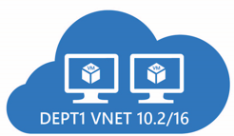
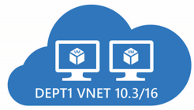
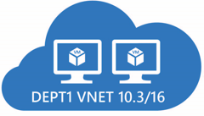
VNet peering transitive behavior
Peering nontransitive
Peer 10.2 to 10.3
Peer 10.3 to 10.4
Does not mean 10.2 is peered with 10.4
Must specifically enable peer between 10.2 and 10.4
4

Slide 44
VNet peering traffic flow behavior
Peer relationship is higher priority for traffic routing over ExpressRoute or VPN connections
VNet can have a single logical gateway either local or remote
Gateway Transit allows a remote gateway to provide on premises connectivity
Peering in the same region is GA; Cross-region peering is in Preview
Requires the peer source to enable remote gateway support
Requires the peer neighbor to enable gateway transit

Slide 45
ExpressRoute
Branch office 2
Microsoft
Predictable performance
WAN
Security
Branch office 1
Public internet
High throughput
Corp HQ
Lower cost
ExpressRoute provides a private, dedicated, high-throughput network connection to Microsoft

Slide 46
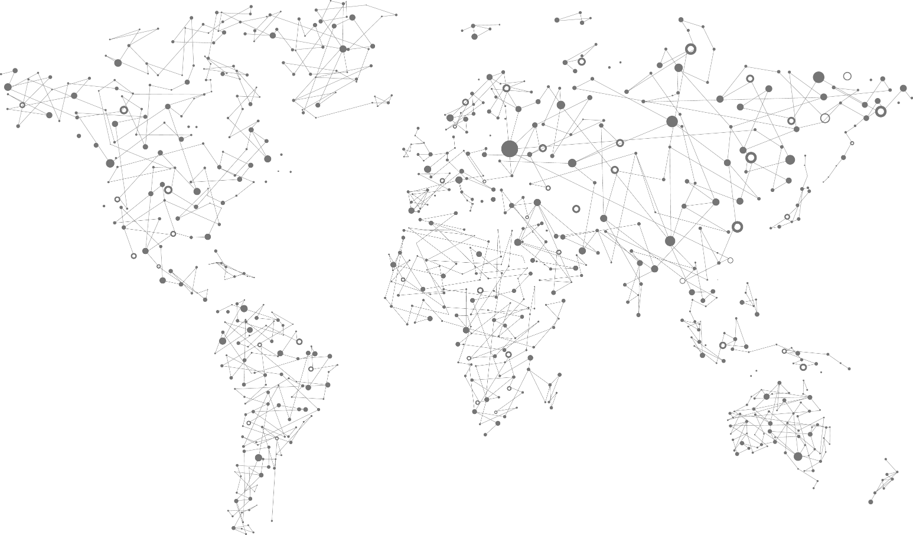
Roadmap
Toronto
Montreal
Dublin
Amsterdam
Chicago
Seattle
Denver
Quebec City
New York City
Newport, Wales
Paris
Seoul
Silicon Valley
Las Vegas
London
Washington DC
Tokyo
Marseilles
Busan
Atlanta
Osaka
Los Angeles
Dallas
San Antonio
Miami
Hong Kong
Chennai
Large partner Ecosystem: 35 → over 100 in 6 months!
Mumbai
Singapore
Johannesburg
Sao Paulo
Cape Town
Sydney
New Sites: Denver, San Antonio, Marseilles, Johannesburg, Cape Town
Melbourne

Slide 47
Roadmap
US Gov Cloud
German Cloud
Berlin
China Cloud
Seattle
Chicago
New York
Frankfurt
San Antonio
Washington DC
Beijing
Silicon Valley
Dallas
Shanghai
Phoenix
ExpressRoute locations
“National clouds”
New Sites: San Antonio, Phoenix, Carrier neutral sites in China

Slide 48
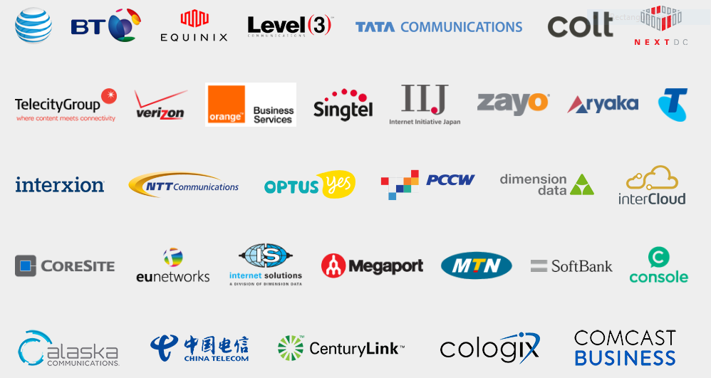
Growing global ExpressRoute ecosystem

Slide 49
ExpressRoute enhancements
Ultra performance ExpressRoute Gateways
Support up to 9G throughput to VNets – up to 5X improvement!
Improved SLA – 99.95% (was 99,9%)
Best cloud enterprise connectivity SLA
More insights
Self-help and troubleshooting tools
Improved monitoring, diagnostics, and alerting
BGP routes, traffic statistics, ARP tables
Network Performance Monitor solution (Preview Dec 2017)
Gateway SKU | Max. throughput (Gbps)
Standard | 1
HighPerformance | 2
UltraPerformance | 9

Slide 50
Recent ExpressRoute releases
New
Migrating deployments from classic to ARM
Move circuits VNets, gateways, vms from classic to ARM without any downtime
Zero down time upgrades
Gateways are protected against planned infrastructure maintenance work; automatic connection draining
Ultra performance gateways
Scales up to 9 Gbps today. 10 Gbps soon.
Connection weights
Pick a preferred circuit to connect to from a specific virtual network
Planned maintenance notifications
Automated notifications to partners
Portal toast for customers
Customer connectivity monitoring through Network Performance Monitor
Part of Operations Management Suite (soon to be integrated with Network Watcher)
Provides latency and packet loss metrics

Slide 51
ExpressRoute Roadmap
Roadmap
Simplified Routing and Prefix management
Route Filters - selective service enablement for Microsoft peering
Merged Azure public and Microsoft peering - Azure regions will be accessible through Microsoft peering
IPv6 support for Office 365 and Azure public services
Higher performance Gateways
Support for SR-IOV in gateways. Lower latency, higher throughput
ExpressRoute monitoring enhancements
Resource Health Check (RHC)
Integration with Azure Monitor
E2E ExpressRoute monitoring
Seamless migration from S2S to ER
No need to disconnect S2S VPN to enable ER
New Locations
South Africa: Johannesburg, Cape Town
France: Marseille
USGov: San Antonio, Phoenix
China: Carrier neutral sites
Australia: Canberra

Slide 52

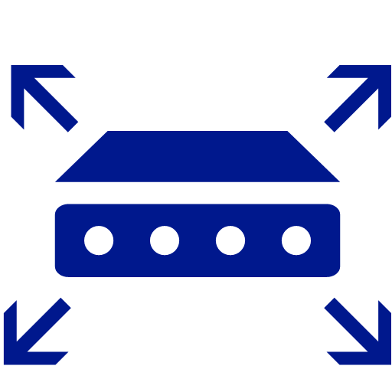

ExpressRoute E2E monitoring
Roadmap
How do you monitor reachability, latency and performance E2E?
Where the problem is?
Branch office (LAN)
Carrier network (WAN)
Cloud connection (ER ckt)
Microsoft Network
Azure VNet / UDR / NSG
Application
How much am I using and how do I plan for capacity increase?
Microsoft Datacenter
Customer Network
Microsoft Edge Site
2
MSEEs
Core
Core
WAN
3
6
4
5
7
Datacenter network
1
8
9
Ability to detect and isolate problems within minutes
Take appropriate action to remediate issues
10
11

Slide 53
ExpressRoute considerations
Understand the models
Differences between unlimited data and metered data
Understand what model you are using today to accelerate adoption
Understand the differences in available port speeds, locations, and approach
Understand the limits that drive additional circuits
Understand the providers
Each offer a different experience based on ecosystem and capabilities
Some provide complete solutions and management
Understand the costs
Connection costs can be broken out by the service connection costs (Azure) and the authorized carrier costs (telco partner)
Unlike other Azure services, look beyond the Azure pricing calculator
Notes:
ExpressRoute circuit limits
10 VNets/circuits
1 VNet can be connected to 4 different circuits
1 circuit across 10 subscriptions
10 dedicated circuits per subscription
Some customers prefer vendors which can support the Exchange Provider peering model while others prefer the Network Service Provider model which establishes MPLS connectivity.
Make sure to obtain the complete end-to-end cost.
Note that in the Exchange Provider model, the customer is responsible for managing routes where NSP the provider manages routes.

Slide 54
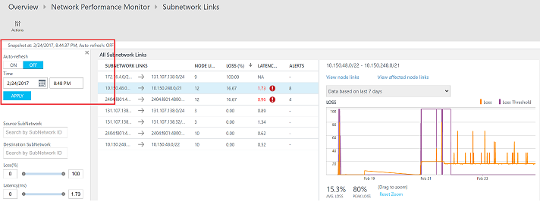
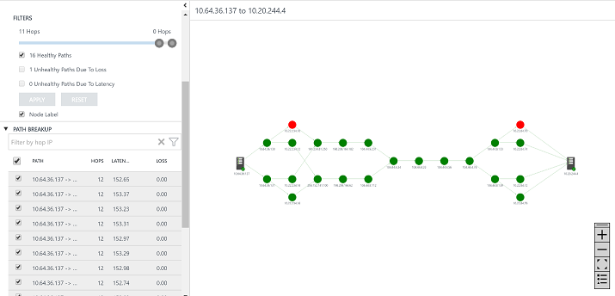
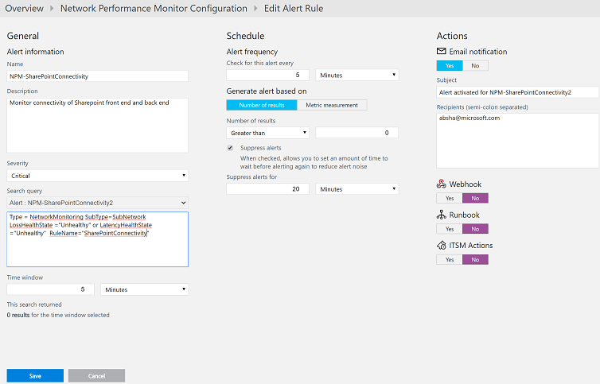
OMS Network Performance Monitor
Continuously measure latency and packet loss from every branch office in your network to Azure
Analyze data using OMS log analytics
Alert and act on key events
Roadmap
NPM is ExpressRoute aware - simplifies fault isolation
Endpoint monitoring - monitoring connectivity to Azure PaaS and Office 365 services

Slide 55
Unlimited versus metered
Unlimited
Speeds from 50 Mbps to 10 Gbps
Unlimited inbound data transfer
Unlimited outbound data transfer
Higher monthly fee
Metered
Speeds from 50 Mbps to 10 Gbps
Unlimited inbound data transfer
Outbound data transfer charged at a predetermined rate per GB
Lower monthly fee
Remark
ER partners often
have similar models
2x2=4 possible combi’s

Slide 56

Deeper insights into your network
ExpressRoute
Peering connection statistics
ARP table, Route Summary, Route Table
Virtual Network
Effective security rules on every NIC
Next hop and effective routes for every NIC in the subnet
Application Gateway
Metrics and alerts
Back-end health information
Azure
Virtual Network
Internet
Back-end
Mid-tier
Front-end
WAN
ExpressRoute

Slide 57
Virtual Networks and Gateways

Slide 58
Virtual Networks and Gateways model
Fundamental first steps:
Each Virtual Network must contain an IP address space and a minimum of one subnet that leverages all or part of the Virtual Network address space.
Establish a gateway subnet to establish remote network communications to on-premises or other Virtual Networks.
Select a type of gateway and create. Policy-based gateways are for establishing low cost connections to a single Virtual Network in Azure. Route-based gateways are used to establish low cost connections to an on-premises environment or to connect multiple VNets for routing purposes in Azure. ExpressRoute gateways are used for connecting on-premises environments to Azure over high speed private connections.

Slide 59
Virtual Network Gateway address model
The gateway subnet has different address space requirements based on the type of gateway created.
A S2S policy-based gateway or a route-based gateway must have a subnet with a /29 CIDR definition. When the gateway is connected, it actually takes the /29 segment and breaks it down into two /30 segments in order to provide redundant connections as part of the site-to-site VPN. The address requirements are the same for a standard and high performance static or dynamic routing gateway.
An ExpressRoute gateway must have a subnet with a /28 CIDR definition. When the ExpressRoute gateway is established, it breaks the /28 into two /29 segments that are used to provide the redundant connections as part of the ExpressRoute circuit establishment.

Slide 60
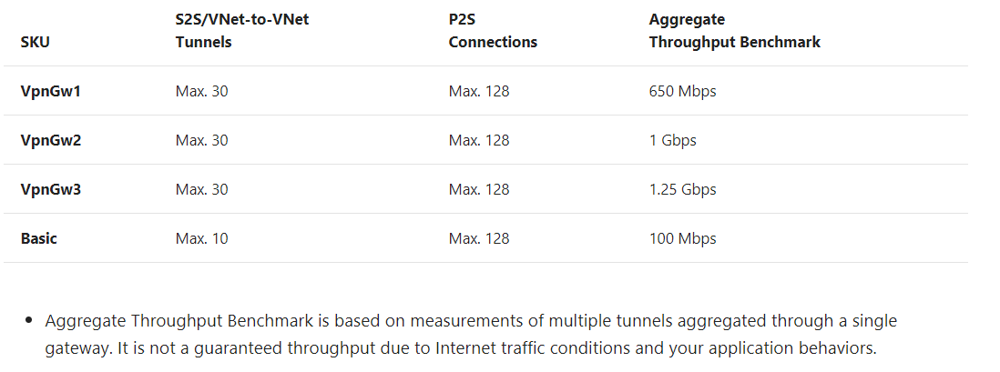
VPN Gateway SKUs

Slide 61
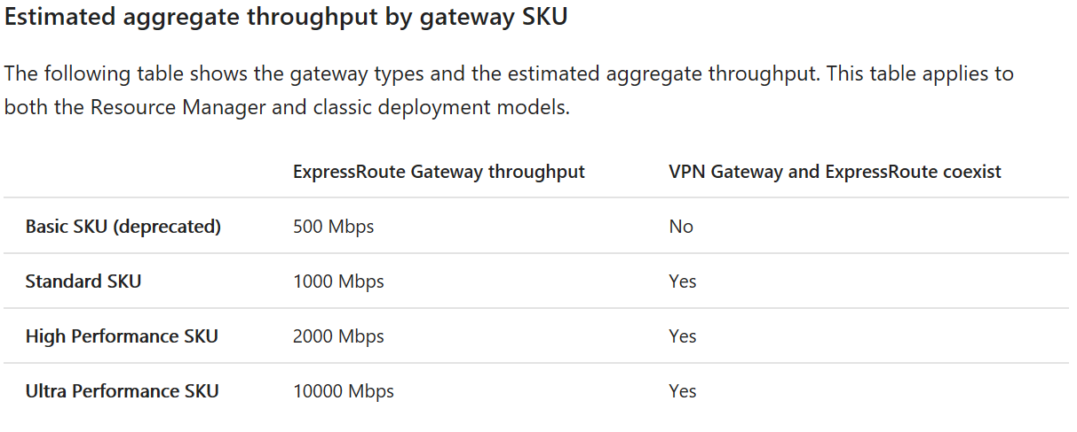
ExpressRoute Gateway SKUs

Slide 62
Virtual Network Gateway address model cont’d
It is possible to deploy a coexistence model where both S2S and ExpressRoute gateways are deployed to a gateway subnet. In this configuration the gateway subnet must have a /27 CIDR definition. In this model the ExpressRoute connection and gateway must be established first, then the S2S gateway and connection can be added.

Slide 63
Virtual Network IP address planning model
Fundamental steps:
Configure non-overlapping IP Address space for their Azure environment. This IP address space can consist of private IPV4 IP address ranges (as described in RFC 1918) or public (non-RFC 1918) IPV4 IP address ranges owned by the organization. Exceptions to public address ranges include the following:
224.0.0.0/4 (Multicast)
255.255.255.255/32 (Broadcast)
127.0.0.0/8 (loopback)
169.254.0.0/16 (link-local)
68.63.129.16/32 (Internal DNS)

Slide 64
Virtual Network IP address planning model
Divide Virtual Networks into smaller groups of address spaces called subnets. Subnets are the connection points for virtual machines and specific PaaS roles, not the Virtual Network. The subnets are connected to the Virtual Network and part of a flat routed network where traffic that flows through the gateway will reach each subnet.
There are two types of subnets that can be created:
Virtual Machine subnet
Gateway subnet

Slide 65
Network connectivity models
Site-to-Site VPN connections use VPN devices over public Internet connections to create a path to route traffic to a Virtual Network in a customer subscription.

Slide 66
Network connectivity models
ExpressRoute connections use routers and private network paths to route traffic to Azure Virtual Networks and optionally the Azure public services. Private connections are made through a network provider by establishing an ExpressRoute circuit with a selected provider.

Slide 67
Network connectivity models – Public peering
When the public peering connection is established, the Azure datacenter routes for all the Azure datacenters worldwide are published to the edge router allowing traffic to make a “hairpin” to the Azure services instead of going out to the Internet.
The interface between the Azure public services and the customer’s network must be protected by redundant NAT firewalls.
These NAT devices allow customers systems to access the Azure public services, but only stateful traffic back to the customer’s networks.
NAT devices are customer responsibility.

Slide 68
Azure S2S network topology

Slide 69
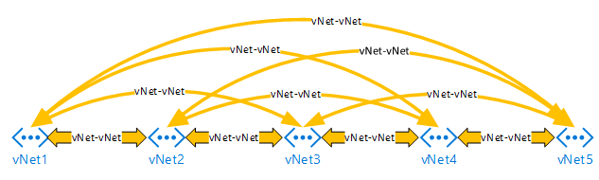
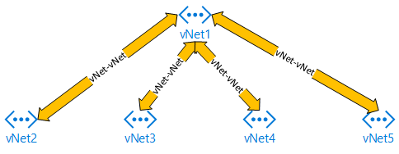
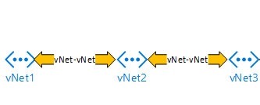
Network topology questions
How is the network infrastructure laid out in Azure?
How does it complement (or counter) the infrastructure you have built on-premises?
Common Virtual Network (VNet) Models:
Mesh
Hub and Spoke
Daisy Chain

Slide 70
VNet-to-VNet routing models
Mesh: Every VNet can talk to every other VNet with a single hop, and therefore does not require the user to define multihop routing. Challenges with this approach include the rapid consumption of gateway connections, which limit the size of the VNet routing capability.
Applies to: VNet peering (single-level only) and S2S VPN

Slide 71
VNet-to-VNet routing models
Hub and Spoke: By default, a Virtual Machine on VNet1 will be able to communicate to a virtual machine on VNet2, VNet3, VNet4, or VNet5. A virtual machine on VNet2 could talk to virtual machines on both VNet1, but not a virtual machine on VNet3, VNet4, or VNet5. This is due to a default single hop isolation of the VNet in this configuration.
Applies to: VNet peering (single-level only) and S2S VPN

Slide 72
VNet-to-VNet routing models
Daisy Chain: A Virtual Machine on VNet1 will be able to communicate to a Virtual Machine on VNet2, but not VNet3, VNet4, or VNet5. A Virtual Machine on VNet2 could talk to Virtual Machines on both VNet1 and VNet3. The same VNet single hop isolation applies.
Applies to: S2S VPN with BGP support

Slide 73
Azure ExpressRoute network topology

Slide 74


ExpressRoute peering
Partner Edge
Microsoft Edge
Customer’s network
Customer’s connection
Microsoft peering
Traffic to Office 365 Services
Public peering
Traffic to public IP addresses in Azure
Private peering
Traffic to Virtual Networks

Slide 75
ExpressRoute scope
Connectivity is based on geopolitical regions (GPR)
North America, South America, Europe, Asia, India, Japan, Australia
ER standard can connect to:
Any VNet in any Azure region in the same GPR (Azure private peering)
Any Azure public service in the same GPR (Azure public peering)
ER Premium add-on enables global connectivity
Cross-GPR connections to VNets in other GPRs than where the circuit is located
To Azure public services in any GPR (Azure public peering)
To MSFT peering for e.g. Office 365 services (see Office 365 guidance for details)
National clouds have their own GPR boundaries
US Government cloud, China, Germany
Details: https://docs.microsoft.com/en-us/azure/expressroute/expressroute-locations

Slide 76
ExpressRoute private topology
ExpressRoute circuit is built within a subscription
Can connect from that circuit to Vnets within the same subscription
Can authorize connections to VNets in other subscriptions (also cross-tenant)
Limit to the number of VNets that can connect to an ER circuit (10-100)
Limit to the number of ER circuits one VNet can connect to (max 4)

Slide 77
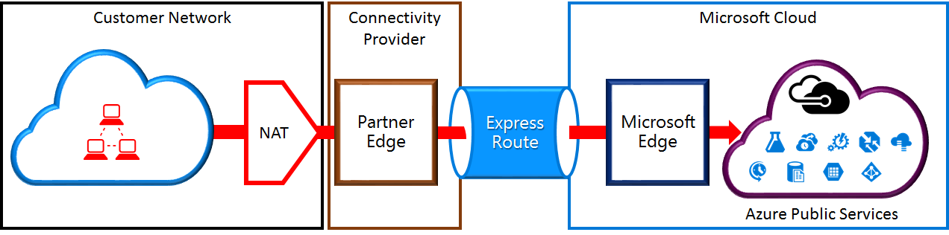
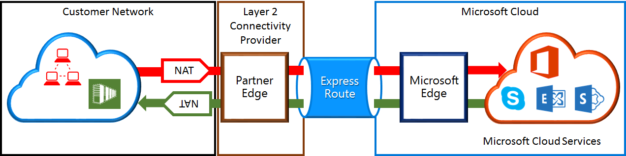
ExpressRoute NAT
Public & MSFT peering
Considerations
NAT sizing
NAT pool monitoring
(Incl. in L3 ER service)
NAT is a customer responsibility
https://docs.microsoft.com/en-us/azure/expressroute/expressroute-nat

Slide 78
ER & prefix capacity planning
Considerations using private peering
# Prefixes @customer >10.000 (max.ER Premium)
Considerations using public and/or MSFT peering
Capacity customer devices (CE may be managed by an NSP)
# ER prefixes public: global >2.600
# ER prefixes public: per GPR see table (r)
# ER IPv4 prefixes MSFT >580
Microsoft Azure Datacenter IP Ranges (10-Nov-2016 monthly update)
Office 365 URLs and IP address ranges
Route redistribution may exceed max #routes CE
Notes:
Known devices with route table limits
Certain models Palo Alto NG firewalls = 5000 (license-based)
E.g. using private and public peering with ER Premium while redistributing all public routes into private results in > 5000 routes.
Verizon SCI when Verizon manages the CE
In some default configs, the CE is capped at max 1.250 routes. When using ER Premium combined with Azure Public, not all Azure advertised routes are accepted (max approx. 1.200 out of > 2.600. Remaining routes are dropped from the routing table.

Slide 79
ExpressRoute BGP ASN + IP space
Requirement: ASN + public IP space (correctly registered)
Challenges:
ASN validation fails? ->MS support case
Many orgs don’t have/can’t get public ASN or public IP
Private ASN public/MSFT peerings OK -> pub IP still needs to be registered with public ASN!
BGP knowledge
L2 vs. L3 ER provider experience
Responsible for ASN + public IP + NAT?
L2 = customer, L3 = ER provider
Choosing L3 provider
can solve some challenges

Slide 80
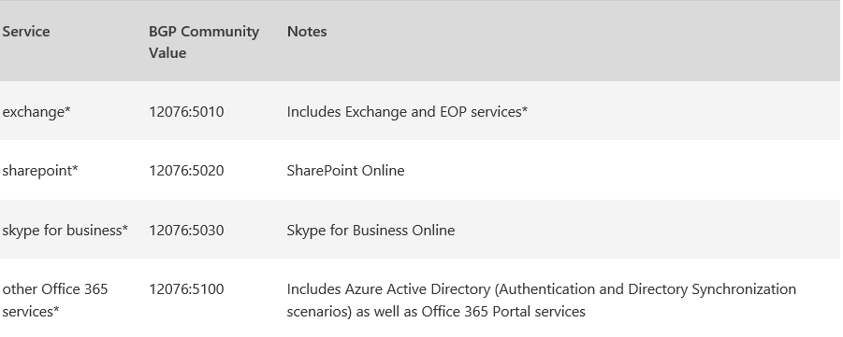
Microsoft peering – BPG attributes & ASN
BGP community attribute:
ASNs reserved for ExpressRoute
Public ASNs: 8075, 8076, 12076
Private ASNs: 65515, 65517, 65518, 65519, 65520

Slide 81
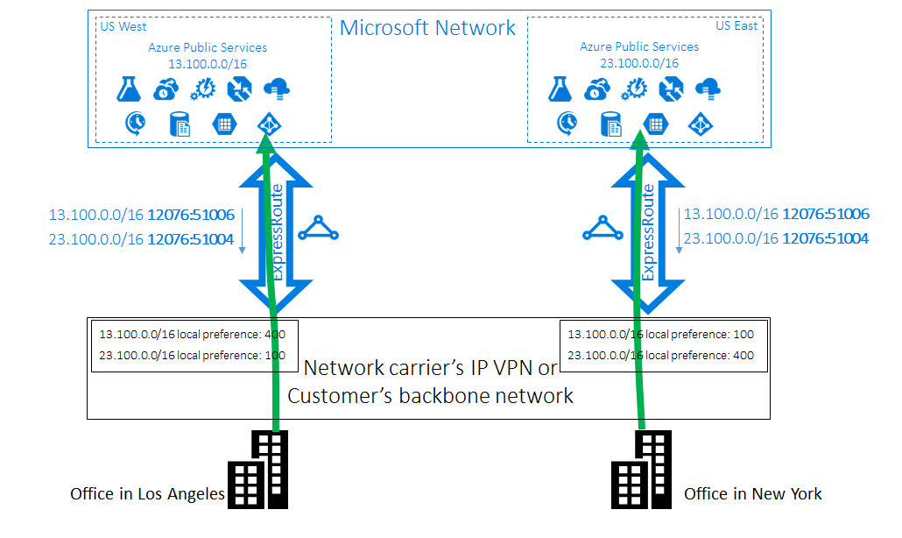
Multi-Site ExpressRoute
Multiple circuits implemented at different customer locations and peered at different Azure Regions:

Slide 82
ER Routing Controls
If multiple Circuits are implemented, configuration must be performed to ensure efficient routing and failover from one side to the other:
BGP Communities
Control which ER circuit will be preferred when accessing Azure Services
AS Path prepending
Influence routing from Microsoft to the customer
Routing Weight
Control preferred path for VNETs linked to multiple ER circuits

Slide 83
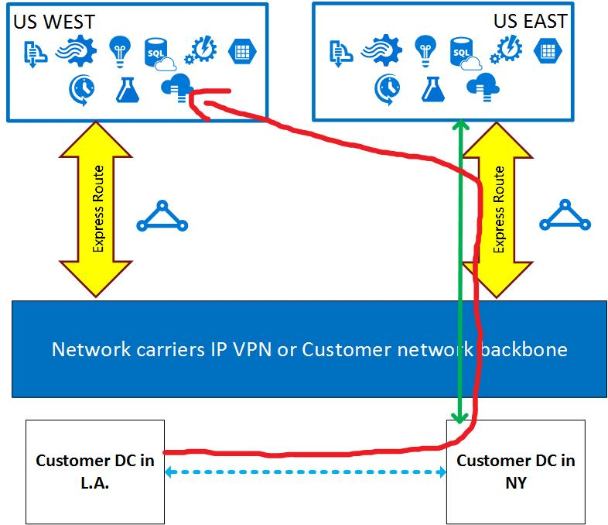
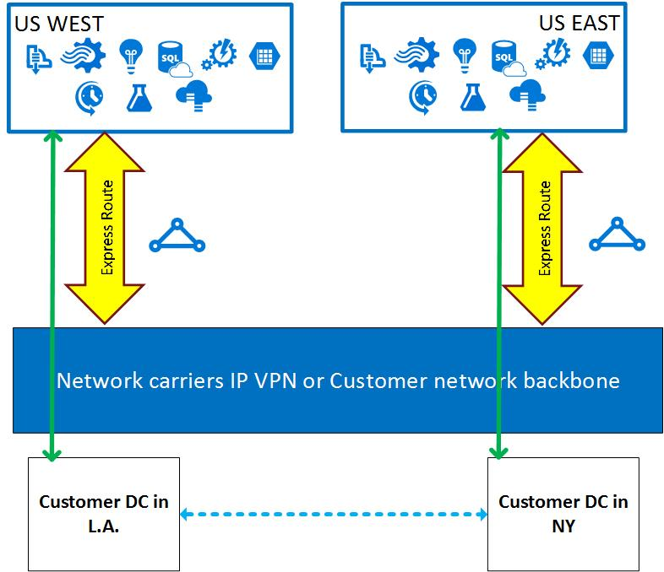
Suboptimal Routing from Customer to Microsoft
Control Routing to Microsoft Services by configuration of BGP Communities

Slide 84
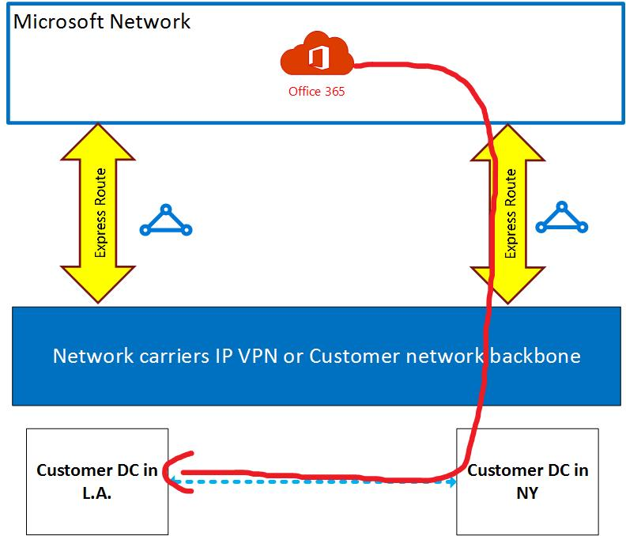

Suboptimal Routing from Microsoft to customer
Control Routing from Microsoft to customer by configuration of AS Path prepending

Slide 85

Suboptimal Routing between VNets linked to multiple ER circuits
From Each VNet there are two paths to the other
ECMP routing is leveraged for load-balancing inter VNET traffic
VNets don´t know which ER Circuit is local
Some traffic flows will take the longer path (red lines)

Slide 86

Routing Weights to control VNet to VNet Routing
VNet receiving the prefix of the other VNet on multiple connections prefers the connection with the highest weight to send traffic destined for that prefix.

Slide 87
DNS

Slide 88

DNS services
Azure DNS
Traffic Manager
DNS
Host your DNS domains in Azure
Integrate your Web and Domain hosting
Globally route user traffic with flexible policies
Enable best-of-class end-to-end user experience

Slide 89
Azure DNS global footprint
Global footprint of DNS servers
Anycast fast query performance
Ultra-available

Slide 90
Routing decisions
If your profile contains multiple endpoints in the same Azure region, then Traffic Manager distributes traffic evenly across the available endpoints in that region
If all enabled endpoints in a given Azure region are degraded, Traffic Manager distributes traffic across all other available endpoints instead of the next-closest endpoint. This logic prevents a cascading failure from occurring by not overloading the next-closest endpoint
When using the Performance traffic routing method with external endpoints or nested endpoints, you need to specify the location of those endpoints. Choose the Azure region closest to your deployment. Those locations are the values supported by the Internet Latency Table

Slide 91
Routing decisions cont’d
The algorithm that chooses the endpoint is deterministic. Repeated DNS queries from the same client are directed to the same endpoint. Typically, clients use different recursive DNS servers when traveling. The client may be routed to a different endpoint. Routing can also be affected by updates to the Internet Latency Table. Therefore, the performance traffic-routing method does not guarantee that a client is always routed to the same endpoint
When the Internet Latency Table changes, you may notice that some clients are directed to a different endpoint. This routing change is more accurate based on current latency data. These updates are essential to maintain the accuracy of performance traffic-routing as the Internet continually evolves

Slide 92
Other considerations

Slide 93

Networking limits

Slide 94

Networking limits

Slide 95

Networking limits

Slide 96

Networking limits

Slide 97

Networking limits

Slide 98
Key decisions

Slide 99
Virtual Network decisions
Mandatory
A minimum of one Virtual Network is needed to establish communication within Azure. Virtual Networks must contain a minimum of one subnet for VM placement and one gateway subnet for cross-premises connectivity
Recommended
Azure solutions should use the route-based routing or ExpressRoute gateway versus the policy-based routing gateway

Slide 100
Gateway decisions
Connecting a Virtual Network to an on-premises environment or to another Virtual Network requires the creation of a Virtual Gateway
Only a single gateway can be attached to a Virtual Network
Mandatory
Since gateways take time to be provisioned create the gateway ASAP after the Virtual Network is created
Use a high performance gateway for ExpressRoute connections of 1Gbps or higher
Use a high performance route-based gateway in S2S scenarios if more than 10 Virtual Network connections are required per gateway or if more than 100 Mbps of throughput are required
Consider using the Coexistence Gateway as the default gateway for all ExpressRoute circuits
Recommended

Slide 101
Gateway decisions
Considerations | Decision points
Gateway provisioning performance | Plan accordingly and decide when to provision the gateway as it can take anywhere from 15-30 minutes for the gateway to be available
Gateway limits | Decide which and how many Virtual Networks will have a gateway deployed. A Virtual Network can have a maximum of a single gateway attached to it
Policy-based Routing Gateway limits | Decide whether to deploy multi-site VPN, VNet-to-VNet, and Point-to-Site VPNs as policy-based routing is not supported of these type of VPN gateways
Co-existence Gateway | Decide whether to deploy a co-existence gateway to provide support for VPN and ExpressRoute connections on the same gateway. The co-existence gateway allows for two modes: Failover and Coexistence
Cisco ASA VPN device | This device has recently started supporting route-based S2S VPN so multiple Virtual Networks can be connected to a Cisco ASA VPN device.

Slide 102
Gateway address decisions
An Azure gateway requires the creation of a gateway subnet in a Virtual Network to create the gateway. The gateway subnet must meet the address requirements based on the type of connection the gateway will support (S2S or ExpressRoute)
Mandatory
Recommended
Create the gateway subnet at the time of Virtual Network creation

Slide 103
VNet-to-VNet routing decisions
Multihop routing requires the decision of a connection model and modification of the default single hop routing
Mandatory
Do not use Mesh connection option based on limitations and expandability due to gateway connection limits
For higher VNet gateway connection limits, deploy the high performance gateway
Recommended

Slide 104
Virtual Network IP address planning decisions
Mandatory: When designing Azure Virtual Network infrastructures, the planning of IP address spaces is a required initial step prior to deployment and configuration of Virtual Networks.
Considerations | Decision points
Virtual Network and subnet configuration | There is a limit on the number of Virtual Networks that can be placed in a subscription but there is not limit for subnets. Subnets have no limits except for the how small the addresses space in the VNet can be subdivided Decide which layer is the most optimal for your environment
Virtual Machines and address space planning | Decide whether to maximize VNet density based on VNet limitations Currently, a Virtual Network can have a total of 2048 Virtual Machines attached to subnets of the Virtual Network. By default, every Virtual Machine has a single NIC, and therefore the Virtual Network space needs a minimum of 2048 IP addresses (plus the 3 for Azure)

Slide 105
Virtual Network IP address planning decisions
Considerations | Decision points
Address space considerations | When designing an address space for a Virtual Network, you need to take the following into consideration: Limit to the number of objects that can consume IP addresses in a Virtual Machine subnet Requirements of the gateway subnet based on type of gateway connection
Planning for internal load balancing | Decide which and how many Virtual Networks will have a gateway deployed. A Virtual Network can have a maximum of a single gateway attached to it
Duplicate or overlapping IP ranges | Decide on total network resources to be deployed to obtain address space ranges using the following formula: Virtual Network address space = # of Virtual machines + # of additional NICS + # of ILBs + 3

Slide 106
Network Connectivity – ExpressRoute peering decisions
Considerations | Decision points
Azure services in the datacenter | Decide on all the routable IP addresses to all Azure datacenter services
Public Peered Services | Any Azure public service will only see the NAT device address. If the Azure public service provides firewall protection, only the NAT addresses can be used in the firewall rules. From a security perspective, specifying the NAT addresses will prevent connections from the Internet for the customer’s instance of that public service Which also means that any system behind the NAT can access the public service which may not be desired from a security perspective Decide who mill managed the routing for these public peered services

Slide 107
Network connectivity – ExpressRoute performance decisions
Considerations | Decision points
Bursting traffic | Decide whether to allow bursting in traffic. ExpressRoute circuits allow for bursting of traffic to up to 2 times the rated bandwidth of the circuit. Gateways and circuits will drop packets if burst limit is exceeded
Standard versus Premium ExpressRoute | Decide whether there is a need to increase the number of routes, number of VNet connections per circuit, and the ability to route traffic across Azure regions. If so, opt for ExpressRoute Premium
Gateway performance | Decide which gateway type to pick for the ExpressRoute circuit. As the maximum speed of the gateway is a function of the SKU and affects performance,

Slide 108
Network connectivity – ExpressRoute provider decisions
Recommended: Ensure that the costs are well understood and that conversations with authorized carriers are addressed early in the planning process.
Considerations | Decision points
IxP connections | Provides a colo for the routers to be placed at the provider access point and manage all the route publishing. The advantage of the IxP model is that the customer is given a rack and allowed to place additional hardware in addition to the router. This allows the customer to place security and other appliances Decide on the IxP model if management of routes is required
NSP connections | For the NSP model, the provider typically provides and manages the provider edge routers and the configuration and management of the published routes. Decide on the NSP connection if MPLS is already in place for your datacenter’s LAN

Slide 109
Network Connectivity – ExpressRoute premium decisions
Service availability and access
While ExpressRoute Premium is available in regions like India and Australia, in order to leverage the cross VNet connectivity, you must have a business presence within the country and a local Azure billing account to establish a cross-region VNet connection.
Decide which region to enable your service based on regions in which ExpressRoute Premium is available.

Slide 110
Network Connectivity Decisions – VPN S2S
Mandatory
A dedicated IPv4 address is required for the on premises VPN device to establish a S2S VPN
Do not use the Mesh connection option based on limitations and expandability due to gateway connection limits
For higher VNet gateway connection limits, deploy the high performance gateway
Leverage Multi-Site S2S support to provide redundant paths to a VNet
Recommended
Optional
Leverage the New-GUID cmdlet to generate a complex shared key

Slide 111
Virtual Network IP address planning decisions
Mandatory: The following is required for implementation of Point-to-Site VPN connections:
A certificate to encrypt the connection
Microsoft VPN client package installed on the workstation
Mac machines use the native IKEv2 VPN client
P2S is only supported with a route-based gateway
Considerations | Decision points
P2S VPN limitations | There exists a maximum of 128 P2S VPN connections per VNet. And the client package is available x86 and x64 Windows clients Decide who to allows access based on the limit of P2S connection
Certificate Requirements | Decide on the certificates that will be needed as self-signed certificates or Enterprise CA-based certificates must be used
Interoperability with ExpressRoute | You can now leverage P2S connections with a VNet connected to an ExpressRoute circuit with gateway limitations lifted (except in case of App Service VNet integration). Decide whether your VNet will need either a ExpressRoute connection as well as P2S connections on specific VNets

Slide 112
IP address decisions
Do not use the Azure portal to shutdown a VM unless you are trying to change its IP address or delete the Virtual machine. Otherwise, you will lose the assigned IP address
Use static IP addresses only when a dynamic will not meet requirements. Do not use them because that is the current on premise approach
Recommended

Slide 113
IP address decisions
Mandatory
Carefully plan and track Static IP address usage to prevent running out of address quota
If more than 5 reserved addresses are required, submit a Azure help desk ticket early to increase the Static address quota to prevent running out and preventing deployments
Leverage Static IP address names that can be easily associated with the service they are being used
Recommended

Slide 115
Appendix

Slide 116
Azure networking versions
ASM versus ARM
ASM objects can only connect to ASM networks
ARM objects can only connect to ARM networks

Slide 117
Global – Traffic manager
Routing policies
Performance – Direct to “closest” service
Weighted – Distribute across all services
Priority – Direct to “backup” if primary fails
Nested profiles
Flexible multi-level policies
www.contoso.com

Slide 118

Regional – Load balancer
www.contoso.com
Load distribution methods
Custom probes
Multiple load-balanced IPs
Internet
Azure
Azure load balancer
In

Slide 119
Internal Load Balancing (ILB)
Internal load balancing (ILB)
Enables load balancing among VMs with private IP addresses
Accessible only from:
Customer VNets
Customer's on-premises VNets
Multi-tier applications with internal-facing tiers require
ILB
HA LOB apps
SQL AlwaysOn
RDP to internal endpoints for added default security
Internet
Microsoft Azure
Public VIP
Customer Virtual Network
External load balancer
Customer on-premises
Internal VIP
Internal
load balancer
Back-end
Front-end
Logic tier

Slide 120
Multiple load-balanced IPs
Common use case: multiple SSL end points
Across one or more VMs
443
443
IP1
A
Z
U
R
E
L
B
SSL Website 1
443
444
SSL Website 2
Internet
IP2
443
445
SSL Website 3
IP3
446
SSL Website 4
443
IP4

Slide 121
Multiple VIPs for load balancer
Simplify designs and reduce cost
Multiple private VIPS on a load balancer
Reuse of back-end ports using Direct Server Return
VIP1:80 (LB) → VIP1:80 (VM)
VIP2:80 (LB) → VIP2:80 (VM)
ILB
AG
AG
AG
SQL
SQL
VM
VM

Slide 122
Multiple IP addresses on VM NICs
IP1
Multiple Private IPs per NIC
Up to 250 IPs per NIC
NSGs, UDRs, Load Balancers on all IPs
Multiple Public IPs per VM
Public IP to any IP on any NIC
Any IP on any NIC to load balancer
Enables NVA-based scenarios
Multiple web & app services using the same standard ports
Failover/portability by moving secondary private IP addresses
Scale out NVAs by adding IP addresses on secondary NICs to load balancer
Public IPs
151.1
10.1.1.5
10.1.1.6
151.2
10.1.2.5
10.1.2.6
151.3
10.1.1.7
10.1.1.8
10.1.2.7
Availability set
back-end pool
151.4
10.1.2.8
“Any VIP to any IP on any NIC”

Slide 123

Multiple VIPs on ILB – Scenarios
Enables critical scenarios, including:
SQL AlwaysOn with multiple listeners for availability groups
Supports standard back-end pools as well as DSR (“floating IP”)
Multiple VMs exposing services on VIPs with same port #
SQL AlwaysOn, multiple AG

Slide 124

IP addresses models

Slide 125

Where is my packet going to – Troubleshooting routes
Effective rules applied on the NIC
Consolidated view of system, BGP and user defined routes
Filtered rules based on LPM
First stop for troubleshooting connectivity issues

Slide 126

HA for NVA (ILB any port)
Preview
High availability for NVA through Azure Internal Load Balancer (ILB)
ILB supports any port, any protocol
UDR supports ILB as next hop IP address
Failover in less than 15 seconds
Any port, any protocol
ILB
DMZ subnet
UDR
Back-end subnet → ILB
VM1
VM2
Firewall Appliance
Back-end subnet

Slide 127
Network Watcher
end to end insights into your network
Topology
Diagnostic Tools
Flow Logs

Slide 128



Network Watcher - Connectivity Check
New
Issue
Customers have no way to determine if connectivity issues are due to infrastructure or misconfiguration
Solution
Network Watcher Connectivity check helps validate connectivity between VMs or between a VM and any endpoint

Slide 129
Network Watcher Roadmap
Roadmap
Continuous network monitoring
Hybrid network monitoring
Living topology
NSG Flow logs bytes and packets
NSG Flow log analytics integration
Map of Internet

Slide 130
Azure network connectivity

Slide 131
Path diversity for on-premises networks
Multiple tunnels/paths between Azure VNet and on-premises site
Use BGP for reachability detection and path failover
Support on-premises network with multiple ISPs and VPN devices
VNet1
East US
ASN 65010
10.11.0.0/16
10.11.0.0/16
IPsec/IKE S2S VPN tunnel 1
Active tunnels with BGP failover
On-premises VPN 1
On-premises
Site 5
ASN65050
10.51.0.0/16
10.52.0.0/16
Azure VPN
IPsec/IKE S2S VPN tunnel 2
On-premises VPN 2

Slide 132
Dual redundancy with Active-active Gateways
Zero downtime during planned maintenance
From active-standby to active-active
Support both cross-premises and VNet-to-VNet connectivity
Spreading traffic over multiple tunnels simultaneously
VNet1
East US
ASN 65010
10.11.0.0/16
10.11.0.0/16
On-premises VPN 1
On-premises
Site 5
ASN65050
10.51.0.0/16
10.52.0.0/16
Azure VPN
On-premises VPN 2

Slide 133

VNet peering
Full-mesh direct connectivity
High bandwidth
Low latency
Classic to ARM Peering
Cross subscription – Same tenant
Hub and Spoke configuration
Billing effective from 11/01

Slide 134
ExpressRoute disaster recovery
ExpressRoute gateways can connect to ExpressRoute circuits in multiple locations
ExpressRoute circuits can be connected to multiple ExpressRoute Gateways
The solution for disaster recovery is multiple ExpressRoute

Slide 135
Multi-path ExpressRoute
What the West Gateway “sees”
Range | AS Path | From
10.1.0.0/16 | 64496 | LA
10.1.0.0/16 | 64496 64496 | NY
10.2.0.0/16 | 64496 | NY
10.2.0.0/16 | 64496 64496 | LA
ExpressRoute gateway is connected to at least two ExpressRoute circuits
All on-premises routes are broadcast to Azure from each ExpressRoute locations
Each individual prefix should have an appropriate AS Path weighting to indicate path preference
ExpressRoute gateway will send traffic to the route with shortest AS Path
For reverse flow, use local preference values on routes advertised from Azure as they arrive to backbone edge routers
Ethernet backbone network
Sent to Azure from LA
Sent to Azure from NY
Range | AS Path
10.1.0.0/16 | 64496
10.2.0.0/16 | 64496 64496
Range | AS Path
10.1.0.0/16 | 64496 64496
10.2.0.0/16 | 64496

Slide 136
Multi-path ExpressRoute
What the West Gateway “sees”
Range | AS Path | From
10.1.0.0/16 | 64496 | LA
10.1.0.0/16 | 64496 64496 | NY
10.2.0.0/16 | 64496 | NY
10.2.0.0/16 | 64496 64496 | LA
In this example; West Gateway would send 10.1.1.1 down the Los Angeles ExpressRoute circuit
If LA ER fails, BGP will drop the routes from LA
The NY path would be used to get to the LA office
To influence traffic flow, use AS Path or Local Preference settings
Sent to Azure from LA
Sent to Azure from NY
Range | AS Path
10.1.0.0/16 | 64496
10.2.0.0/16 | 64496 64496
Range | AS Path
10.1.0.0/16 | 64496 64496
10.2.0.0/16 | 64496

Slide 137
Networking in V1 and V2 stack
ASM stack
ARM stack
Portal
Svc Mgmt API
Portal
ARM API
(GLOBAL)
RDFE (GLOBAL)
REGIONAL
NRP
NRP
REGIONAL
REGIONAL
RNM
RNM
RNM
RNM
CLUSTER
CLUSTER
FC
NSM
FC
NSM
FC
NSM
FC
NSM
HOST
SDN
HOST
SDN
HOST
SDN
HOST
SDN
HOST
SDN
HOST
SDN

Slide 138


Azure network planning
Three main areas in Azure network planning regardless of the application or service being hosted:
Connectivity
Topology
Ingress
Notes:
When planning Azure networking, there are three main areas in Azure network planning customers need to address regardless of the application or service being hosted

Slide 139

ExpressRoute peering locations

Slide 140
Growing global ExpressRoute ecosystem

Slide 141





















Expanding the virtual appliance ecosystem

Slide 142
Force tunneling “failsafe”
With forced tunneling, all internet bound traffic is forced to on-premises due to the 0/0 prefix being advertised in BGP by the on-premises network
But what if ExpressRoute or BGP fails? How can we stop VMs in Azure from talking out to the internet?
Layered NSG routes!!
With Forced Tunneling enabled, 0/0 is considered part of the VirtualNetwork tag as long as BGP is broadcasting it to the ExpressRoute or VPN gateway
All internet addresses (ie 0/0 minus RFC 1918) are in the Internet tag

Slide 143
Force tunneling “failsafe”
Inbound connections are stateful, so they can be used to access to the endpoint
Use layered NSGs to prevent Internet egress if default route is withdrawn

Slide 144
Network performance

Slide 145
Introduction to network performance
Our ability to accompany customers build a Hybrid Cloud Network Architecture that is secure and high performing is crucial to differentiate our cloud services across Azure and Office 365.
In this section, we discuss key options & parameters that influence network performance when connecting to Azure:
TCP Protocol heuristic – 3 Way handshake, Options (Window Scaling, SACK, MSS)
Network Latency
Routing
vRSS
Packet loss
The above mentioned are relevant to on-premises scenarios too, but are far more critical for Azure due to the increase in network latency.
Notes:
[EDITOR] Rajashree Ghosh (Spectrum Consultants India Pvt):
06 December 2011 <Please be informed that the words/phrases/punctuations marked in red are my additions/alterations in this ppt.
>

Slide 146
TCP connection establishment
100.1.0.1
100.1.0.2
100.1.0.3
100.1.0.4
100.1.0.5
100.1.0.6
Name Resolution
Three Way Handshake
Proxy Authentication?
SSL Authentication
Do Work
Notes:
[EDITOR] Rajashree Ghosh (Spectrum Consultants India Pvt):
06 December 2011 <Please be informed that the words/phrases/punctuations marked in red are my additions/alterations in this ppt.
>

Slide 147
TCP Three Way Handshake
The TCP Three Way Handshake can tell us a lot about the connection
How far away the responding machine is
If we have a device in the middle (example: Proxy, WAN Optimizer)
Network-level latency to the responding device
Maximum packet size feasible
Maximum throughput possible on the link
TCP options, which could affect throughput performance
It is therefore key to capture this information when troubleshooting
Also key to capture at client and egress point
Notes:
[EDITOR] Rajashree Ghosh (Spectrum Consultants India Pvt):
06 December 2011 <Please be informed that the words/phrases/punctuations marked in red are my additions/alterations in this ppt.
>

Slide 148
TCP 3 Way Handshake
TCP Three Way Handshake
SYN SrcPort:3333,DstPort:443
SYN –ACK SrcPort:443,DstPort:3333
ACK SrcPort:3333,DstPort:443

Slide 149
TCP - Session Basics No Response | SYN Retransmit
TCP – Session basics
No response | SYN retransmit
SYN
SYN
SYN
Notes:
Discussion: Why would this happen?
Maybe nothing is listening on the port in question
Server does not exist (bad name resolution or bad ARP responses)
Network/route problem
Firewall

Slide 150
TCP- Session Basics TCP Reset | Rejected Session
TCP – Session basics
TCP reset | Rejected session
SYN
RST
Notes:
Discussion: Why would this happen?
Maybe nothing is listening on the port in question
Firewall

Slide 151

TCP Options
TCP – Session basics
The TCP options are where both sides negotiate various things to agree how the connection will work
These are key to the performance and efficiency of TCP connection
Key options are:
MaxSegment Size
WindowScaleFactor
SACK

Slide 152
Maximum Segment Size (MSS)
Maximum Segment size or MSS is a TCP-level value which is the largest segment which can be sent on the link minus the headers
To obtain this value, take the IP-level Maximum Transmission Unit (MTU) and subtract the IP and TCP header size
For a standard Ethernet connection with minimum size IP and TCP headers, we subtract 40 bytes from the 1500 byte standard packet size (minus the Ethernet Header), leaving us with an MSS of 1460 bytes for data transmission
Therefore, to get the most efficient use of a standard Ethernet connection, we want to see an MSS of 1460 bytes being used on our TCP sessions
This value shouldn’t be confused with MTU which is the Maximum Transmission Unit which is the payload plus headers
Notes:
http://blogs.technet.com/b/onthewire/archive/2014/06/27/checking-your-tcp-packets-are-pulling-their-weight-tcp-max-segment-size-or-mss.aspx

Slide 153

MSS
Lower of the values seen in the two frames (Syn & Ack Syn) is used on the TCP connection
Smaller values than 1460 can be expected due to smaller network segments or overheads (for example IPSec headers)
Anything smaller than expected by the customer’s network team should be highlighted, as it can affect performance
This should be checked on traces taken on both sides of the egress point

Slide 154
Selective Acknowledgement (SACK)
TCP is a reliable protocol, in that it ensures delivery of all data
It does this by the ACKs indicating it has received up to a certain point in the data stream. This data stream is essentially a sequence of numbers
As an example, if we send 1460 bytes and our last sequence number was 40000 then the ACK sent back to the machine which sent those 1460 bytes, will be 41460 and so on, as the sequence number is incremented by the byte size received and thus the sender knows the data arrived safely
We generally send a burst of these packets and the receiver ACKs every other one
What happens if we send 6 packets and packet 3 goes missing en-route? Without SACK, we'd have to drop packets 5 & 6 and ACK 2 to indicate to the sender that that's the point we'd got up to until we'd noticed a packet missing.
The sender would then have to retransmit packet #3, followed by 4,5, & 6, which obviously isn't efficient as we'd already received them but had to drop them. This also takes time and thus slows data transfer
With SACK enabled, we're able to tell the sender we're missing a packet and also what other packets we've got. So in essence we can say to the sender, "Hey, I've got packets 1-2, and also 4,5, & 6," the sender can therefore retransmit just packet #3 and thus we save having to retransmit 4,5,6 (and any other subsequent packets which arrived before the retransmission of 3 arrived)

Slide 155

SACK
SACK option is in Syn and Ack Syn frames
We should see it enabled in both frames
If not, this should be flagged and the device disabling it, remediated

Slide 156
TCP window scaling
If disabled, limits throughput and will reduce performance, especially when high RTT is apparent
Windows has this enabled by default
Proxies/Firewalls/NAT may not
Without this enabled, we’re limited to a 64k TCP receive buffer
The scale factor is a multiplier of this value
(2^scale factor)*window size

Slide 157
Impact of TCP window scaling
Presuming a 1000 Mbps link here is the maximum throughput, we can get with TCP window scaling disabled, and then with it enabled.
Round trip time (ms) | Maximum throughput (Mbit/sec) without scaling | Maximum throughput (Mbit/sec) with scaling
300 | 1.71 | 447.36
200 | 2.56 | 655.32
100 | 5.12 | 1310.64
50 | 10.24 | 2684.16
25 | 20.48 | 5368.32
10 | 51.20 | 13420.80
5 | 102.40 | 26841.60
1 | 512.00 | 134208.00

Slide 158
TCP packet loss
Cause for poor performance
Easy to spot with a network trace
In Netmon the filter Property.TCPRetransmit == 1 will highlight
Retransmits
>1% consistently, should be
investigated
Azure
Notes:
Validate performance using iperf or ntttcp
Refer -
[EDITOR] Rajashree Ghosh (Spectrum Consultants India Pvt):
06 December 2011 <Please be informed that the words/phrases/punctuations marked in red are my additions/alterations in this ppt.
>

Slide 159
vRSS
vRss (virtual RSS) needs to be enabled on Virtual Machines to achieve throughput greater than 1 Gbps.
Enable vRSS: Get-NetAdapter | % { Enable-NetAdapterRss -Name $_.Name } Increase buffers: Get-NetAdapter | % { Set-NetAdapterAdvancedProperty -Name $_.Name -DisplayName "Receive Buffer Size" -DisplayValue "16MB" } Get-NetAdapter | % { Set-NetAdapterAdvancedProperty -Name $_.Name -DisplayName "Send Buffer Size" -DisplayValue "32MB" } *NOTE* The above will not work in Windows 2012 as the buffer send/receive is limited to 8MB if they have not updated their integration components. With the latest integration components, it will be 16MB/32MB.
Notes:
Validate performance using iperf or ntttcp
Refer -
[EDITOR] Rajashree Ghosh (Spectrum Consultants India Pvt):
06 December 2011 <Please be informed that the words/phrases/punctuations marked in red are my additions/alterations in this ppt.
>

Slide 160
Latency (RTT)
Use PSPing
Creates a TCP session to a port and IP address which works round port blocking
ICMP May also take a different route to TCP or be prioritized differently
If using a VPN endpoint or edge router, we need to measure to the endpoint or router
This gives us RTT to the managed egress point (Internal)
Indicates whether there is a problem within the managed network
Next, take a network trace or PSPing from egress (External)
Indicates the remaining RTT from perimeter to Azure
Internal plus external RTT should give us the combined RTT
Notes:
Validate performance using iperf or ntttcp
Refer -
[EDITOR] Rajashree Ghosh (Spectrum Consultants India Pvt):
06 December 2011 <Please be informed that the words/phrases/punctuations marked in red are my additions/alterations in this ppt.
>

Slide 161
Latency check
C:\Tools\PSTools>psping.exe -n 10 pringle.cloudapp.net:58529
PsPing v2.01 - PsPing - ping, latency, bandwidth measurement utility
Copyright (C) 2012-2014 Mark Russinovich
Sysinternals - www.sysinternals.com
TCP connect to 40.127.134.111:58529:
11 iterations (warmup 1) connecting test:
Connecting to 40.127.134.111:58529 (warmup): 143.90ms
Connecting to 40.127.134.111:58529: 154.77ms
Connecting to 40.127.134.111:58529: 142.78ms
Connecting to 40.127.134.111:58529: 143.62ms
Connecting to 40.127.134.111:58529: 144.40ms
Connecting to 40.127.134.111:58529: 150.57ms
Connecting to 40.127.134.111:58529: 142.84ms
Connecting to 40.127.134.111:58529: 142.71ms
Connecting to 40.127.134.111:58529: 145.76ms
Connecting to 40.127.134.111:58529: 150.07ms
Connecting to 40.127.134.111:58529: 143.27ms
TCP connect statistics for 40.127.134.111:58529:
Sent = 10, Received = 10, Lost = 0 (0% loss),
Minimum = 142.71ms, Maximum = 154.77ms, Average = 146.08ms
Using Psping, we notice the average latency to endpoint is 146.08ms.
Notes:
Validate performance using iperf or ntttcp
Refer -
[EDITOR] Rajashree Ghosh (Spectrum Consultants India Pvt):
06 December 2011 <Please be informed that the words/phrases/punctuations marked in red are my additions/alterations in this ppt.
>

Slide 162

Latency – putting it all together
Client
VPN/Edge Router
20ms
280ms
Azure
Internal RTT (ms) | External RTT (ms) | Total RTT to Azure
20 | 280 | 300
This gives us clear view of internal and external RTT, which can be benchmarked and referred to when there are latency issues
Notes:
Validate performance using iperf or ntttcp
Refer -
[EDITOR] Rajashree Ghosh (Spectrum Consultants India Pvt):
06 December 2011 <Please be informed that the words/phrases/punctuations marked in red are my additions/alterations in this ppt.
>

Slide 163
Routing
It is essential to check the network route taken from the customer site to Azure
Aim is to hit the Microsoft network as quickly as possible
This often will not work from a client machine
Needs to be done from client to egress point if possible and then from egress point to Azure
Key to know route markers, so you can follow route
Take a tracert to all services so you can confirm for each site that the route is as efficient as possible
SharePoint wont respond to ICMP, but the last router that does is in the DC where the tenant is
Notes:
Validate performance using iperf or ntttcp
Refer -
[EDITOR] Rajashree Ghosh (Spectrum Consultants India Pvt):
06 December 2011 <Please be informed that the words/phrases/punctuations marked in red are my additions/alterations in this ppt.
>

Slide 164
Routing check
Tracert to an Azure endpoint
tracert pringle.cloudapp.net
C:\Tools\PSTools>tracert pringle.cloudapp.net
Tracing route to pringle.cloudapp.net [40.127.134.111]
over a maximum of 30 hops:
1 1 ms 2 ms 1 ms 10.2.0.2
2 6 ms 11 ms 4 ms 80.76.165.33
3 407 ms 95 ms 2 ms 192.168.1.9
4 4 ms 5 ms 4 ms 185.100.209.130
5 4 ms 4 ms 5 ms 185.100.209.129
6 136 ms 136 ms 135 ms 185.100.209.7
7 * * * Request timed out.
8 143 ms 142 ms 144 ms be-72-0.ibr02.lts.ntwk.msn.net [104.44.9.154]
9 143 ms 145 ms 142 ms be-3-0.ibr02.dub30.ntwk.msn.net [104.44.5.4]
10 * * * Request timed out.
11 143 ms 144 ms 142 ms ae12-0.db3-96c-2a.ntwk.msn.net [204.152.141.89]
In this example we hit Microsoft network in about 143ms.
We traverse via Dublin.
Notes:
Validate performance using iperf or ntttcp
Refer -
[EDITOR] Rajashree Ghosh (Spectrum Consultants India Pvt):
06 December 2011 <Please be informed that the words/phrases/punctuations marked in red are my additions/alterations in this ppt.
>

Slide 165
DNS

Slide 166
Azure Traffic Manager scenarios
Build high performing cloud applications
Planning for disaster recovery
Upgrade cloud applications seamlessly

Slide 167
Azure Traffic Manager policies
Performance
Priority
Weighted
Directs the user to the “best”/”closest” deployment
Example: Direct the user to the “best” deployment between US South and West Europe
One deployment is primary
Traffic is redirected to another deployment if the primary goes down
Example: All traffic is directed to US North; if it goes down, send all traffic to US South
Equal distribution of traffic between hosted services
Example: 50% users will go to US North and 50% will go to US South

Slide 168

Traffic Manager
Traffic Manager is:
www.contoso.com
DNS-based traffic routing service
Active health monitoring and automatic failover
CNAME
With Traffic Manager, you can:
contoso.trafficmanager.net
Route incoming traffic across multiple Azure services to provide your applications high performance
Automatically fail over between deployments, for high availability
Manage traffic across cloud and on-premises endpoints for hybrid applications and cloud migration
Easily add/remove deployments from active use, allowing seamless upgrades
Traffic routing
Endpoint monitoring
Cloud service
Web app
Non-Azure
endpoints

Slide 169
Profile details
Only a single traffic routing method can be selected in a profile
Routing methods can be changed at any time
Changes go into effect within one minute, with no downtime

Slide 170
Traffic Manager – Nested profiles
Manage user traffic to your applications with high flexibility
Example: Cross-region failover within a Geo, plus in-region flighting
Level 1: Route to user’s nearest Geo (US, EU, ASIA)
Level 2: Route to nearest region, with cross-region failover within the Geo
Level 3: Within the region, divert 1% for flighting
US West
US East
Europe North
Europe West
Cloud services

Slide 171

Priority traffic
By default, Traffic Manager sends all traffic to the primary (highest-priority) endpoint. If the primary endpoint is not available, Traffic Manager routes the traffic to the second endpoint. If both the primary and secondary endpoints are not available, the traffic goes to the third, and so on
Priority property is a value between 1 and 1000. Lower values represent a higher priority

Slide 172

Weighted traffic
Weights are defined from 1 to 1000
Gradual application upgrade: Allocate a percentage of traffic to route to a new endpoint, and gradually increase the traffic over time to 100%
Application migration to Azure: Create a profile with both Azure and external endpoints. Adjust the weight of the endpoints to prefer the new endpoint
Cloud bursting for additional capacity: Quickly expand an on-premises deployment into the cloud by putting it behind a Traffic Manager profile. When you need extra capacity in the cloud, you can add or enable more endpoints and specify what portion of traffic goes to each endpoint

Slide 173

Performance traffic
The 'Performance' traffic-routing method determines the closest endpoint by measuring network latency
Traffic Manager maintains an Internet Latency Table to track the round-trip time between IP address ranges and each Azure datacenter
Traffic Manager looks up the source IP address of the incoming DNS request in the Internet Latency Table. Traffic Manager chooses an available endpoint in the Azure datacenter that has the lowest latency for that IP address range, then returns that endpoint in the DNS response
The IP address used to determine the 'closest' endpoint is not the client's IP address, but it is the IP address of the recursive DNS service

